Slide 1
Fast and Efficient Bipartite Graph Compression
Fall 2022, ADM Final Project
Progress Report
Jongjin Kim, Kahyun Park, Jaemin Park, Jaeri Lee

Slide 2
Overview
Reordering of vertices is a widely used approach to reduce the storage capacity of a given graph’s adjacency matrix
Bipartite graph (e.g. user-item purchase, music-artist) compression differs from other graph compressions
Aim of this research is to develop new vertices reordering method which considers the properties of bipartite graphs
We introduce Iterative Bucket Shingle Ordering (IBSO), which utilizes the property of bipartite graph to improve graph compression efficiency

Slide 3
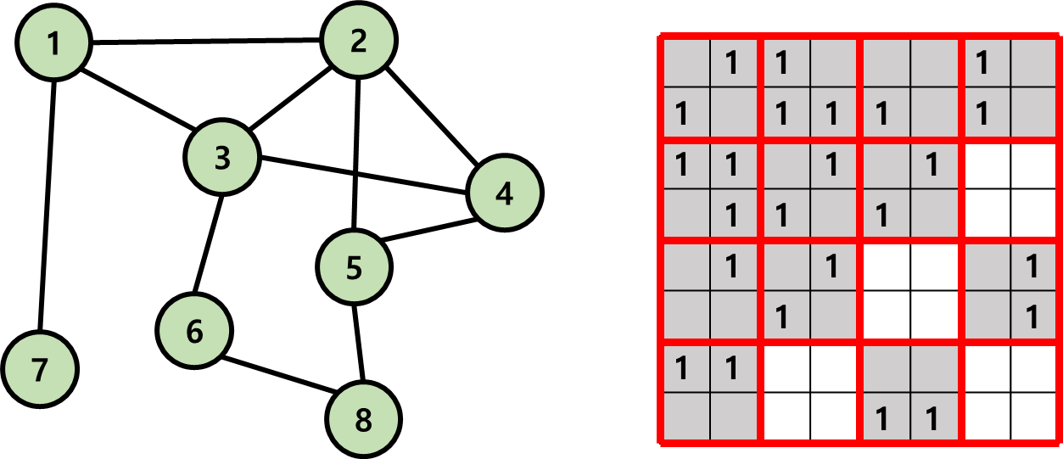
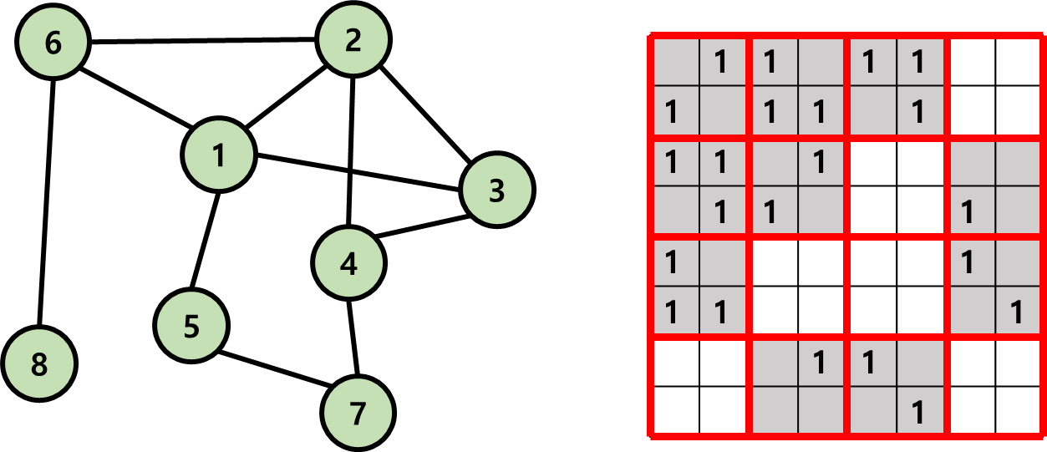
Vertices Reordering
Order of vertices is important to make compression-friendly adjacancy matrix.
We reduce the count of nnz blocks by 16.67% in following example!
12 nonzero blocks
10 nonzero blocks

Slide 4
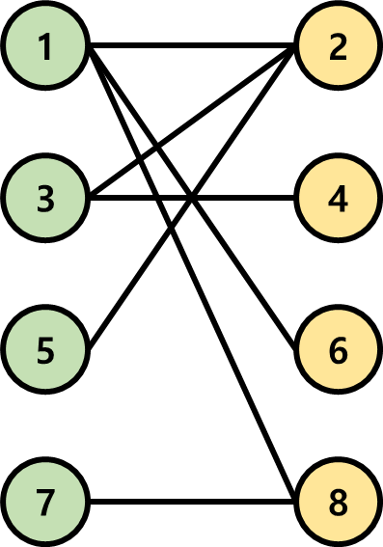
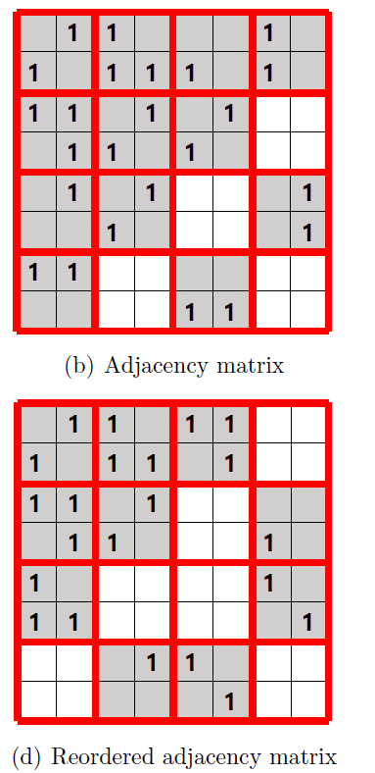
Problem Definition
Given, a bipartite graph G=(V, E)
a block size k
Find, a permutation of vertices P
To Minimize, the number of nonzero blocks of size k x k in the adjacency matrix

Slide 5
Fundamental Sparsity in Bipartite Graph
1
2
 | 1 |  |  |  | 1 |  | 1
1 |  | 1 |  | 1
 | 1 |  | 1
 |  | 1
 | 1
1
 |  |  |  |  |  |  | 1
1 |  |  |  |  |  | 1
Colored elements of the matrix are fixed to zero.
Which leads to fundamental sparsity in blocks. → The number of nonzero blocks↑
3
4
5
6
7
8

Slide 6
Challenges and Main Ideas
We tried to find a solution for the following three challenges:
C1: How to remove the fundamental sparsity of the bipartite graph?
C2: How to get benefit from the property of bipartite graph?
C3: How to order vertices to form denser blocks in an adjacency matrix?
The main ideas of our proposed IBSO are as follows:
Separation: IBSO separates indices of two partitions to gather fundamentally black elements into limited areas.
Iterative Process: IBSO iteratively sorts each partition to take advantage of independency between two partitions.
Bucket Shingle Ordering: IBSO sorts vertices based on the bucket min-hash function to group vertices in similar blocks

Slide 7
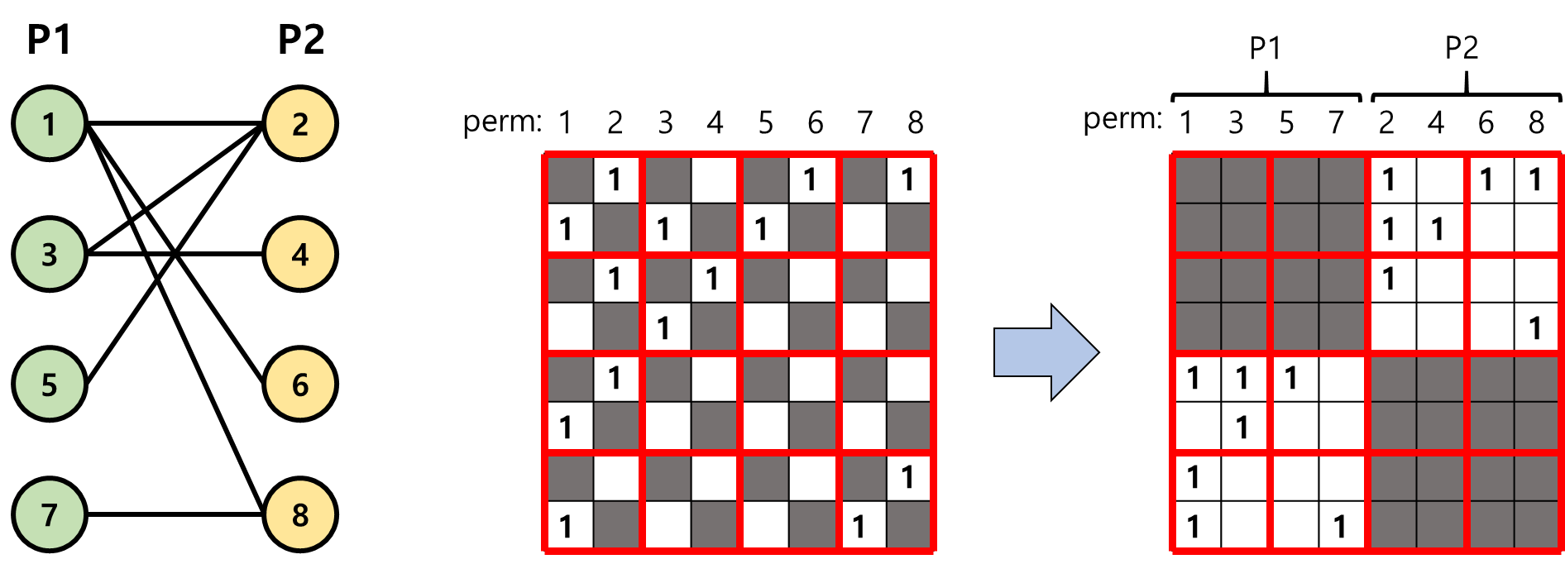
Proposed Method (1)
Idea 1: Separation
IBSO groups the nodes of each partition and separates those in the permutation as shown below
As a result of the separation process, fundamentally blank entries and possible nonzero entries are isolation, which allows nonzero block to exclude vacant elements to achieve the highest density

Slide 8
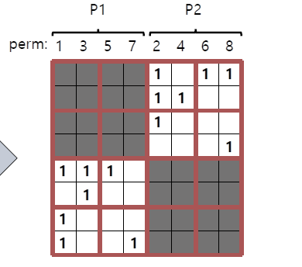


Proposed Method (2)
Idea 2: Iterative Process
Using the result from the separation process, the adjacency matrix is now composed to rows and columns that represent each one of the partitions
The bottom-left half of the adjacency matrix is addressed as a Cross Partition Submatrix (CPS), and its rows and columns are independent
Thus, the order of rows in CPS may be exchanged without considering the columns
① Freeze the permutation of one partition
1 | 1 | 1
 | 1
1
1 |  |  | 1
Cross Partition Submatrix
② Solve the problem on the other partition
“Easier” Problem
③ Freeze the solved partition and iterate the process

Slide 9
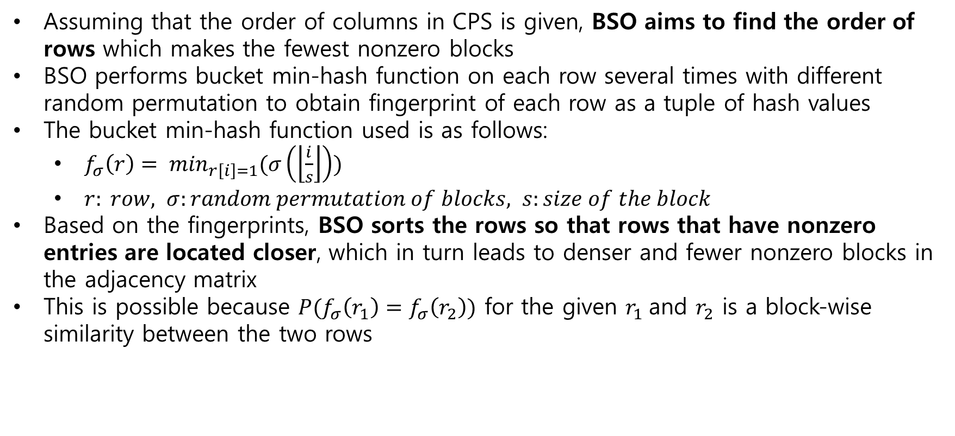
Proposed Method (3)
Idea 3: Bucket Shingle Ordering (BSO)
Assuming that the order of columns in CPS is given, BSO aims to find the order of rows which makes the fewest nonzero blocks
BSO performs bucket min-hash function on each row several times with different random permutation to obtain fingerprint of each row as a tuple of hash values
The bucket min-hash function used is as follows:
$f_{σ}\left(r\right)= \min_{r\left[i\right]=1}(σ\left(\left\lfloor \frac{i}{s}\right\rfloor \right))$
$r: row, σ:random permutation of blocks, s:size of the block$
Based on the fingerprints, BSO sorts the rows so that rows that have nonzero entries are located closer, which in turn leads to denser and fewer nonzero blocks in the adjacency matrix
This is possible because $P(f_{σ}\left(r_{1}\right)=f_{σ}\left(r_{2}\right))$ for the given $r_{1}$and $r_{2}$ is a block-wise similarity between the two rows

Slide 10
Proposed Method (4)
Idea 3: Bucket Shingle Ordering (BSO)
blk ord:
2
4
1
3
hash vals
a
→ 2
b
b
→ 1
d
c
→ 2
a
d
→ 1
Sorting
c
e
→ 3
e
9 nnzs
8 nnzs
(1) bucket minhash
(2) fewer nonzero blocks

Slide 11
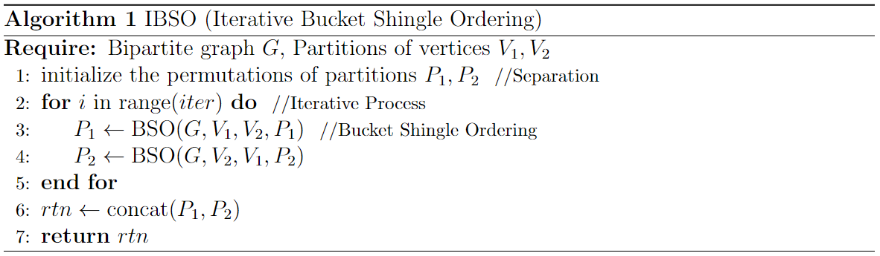
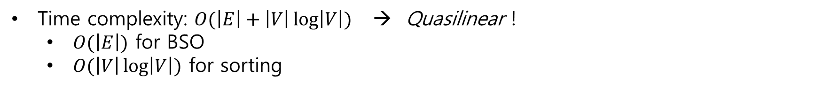
Proposed Method (5)
IBSO: Iterative Bucket Shingle Ordering
Time complexity: $O(\left|E\right|+\left|V\right|\log\left|V\right|)$ → Quasilinear !
$O(\left|E\right|)$ for BSO
$O(\left|V\right|\log\left|V\right|)$ for sorting

Slide 12
Research Questions
The three questions that we tried to answer through experiments are:
Q1: Performance
How well does IBSO compress bipartite graphs compared to other methods?
Q2: Speed
How quickly can we perform the compression with IBSO?
Q3: Visualization
How does the adjacency matrix of IBSO look like?

Slide 13
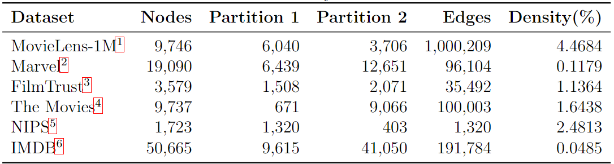
Experimental Setup
Six real-world bipartite graph datasets
Nine baselines
Five unipartite baselines
Random, DegSort, BFS, SO, SlashBurn
Four bipartite baselines
Bi-Random, Bi-DegSort, Bi-SO, FastPI (Bi-SB)

Slide 14
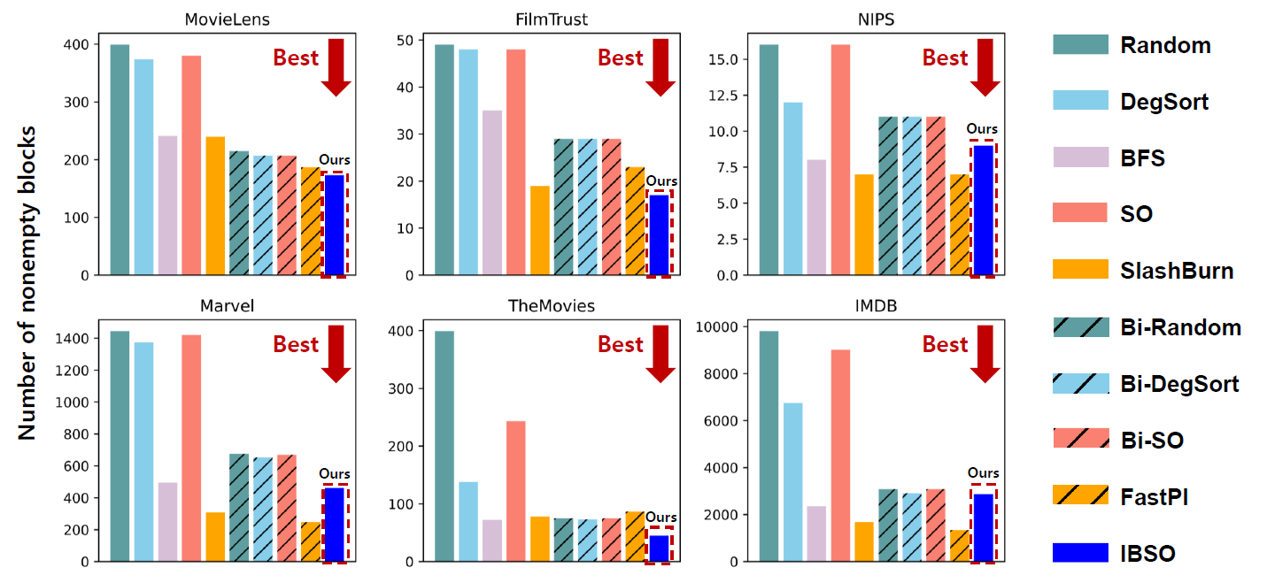
Experiments (1)
Following are the results from the performance evaluation:

Slide 15
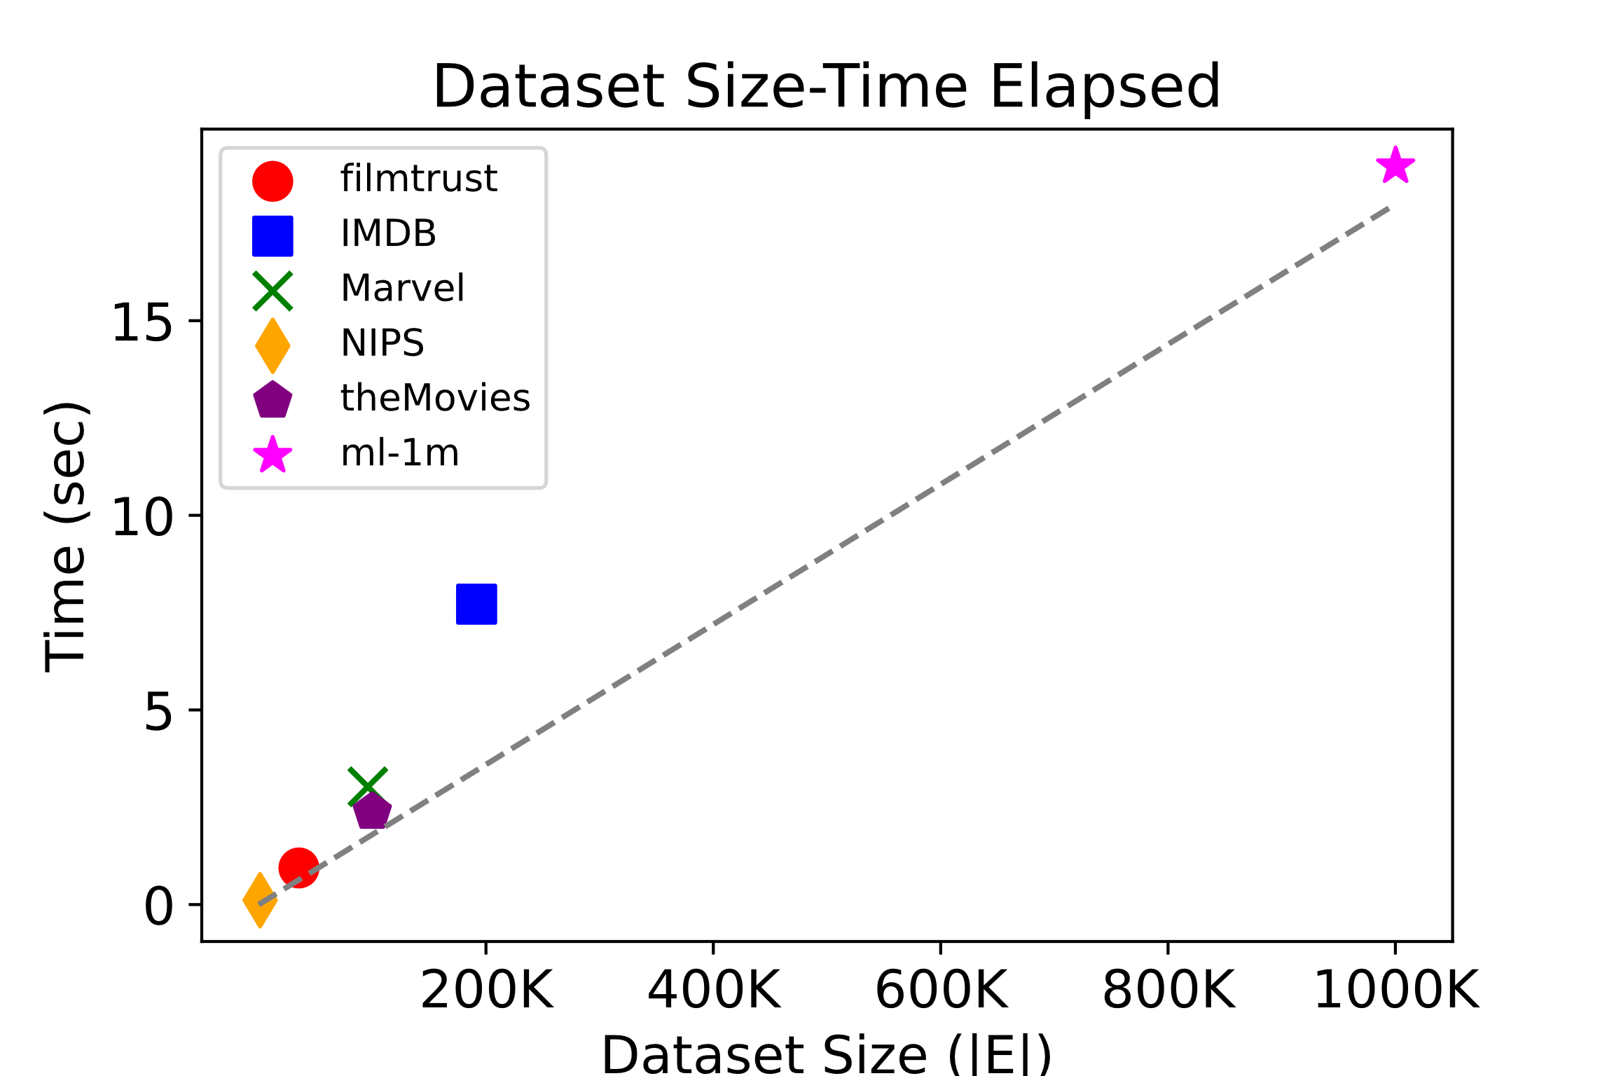
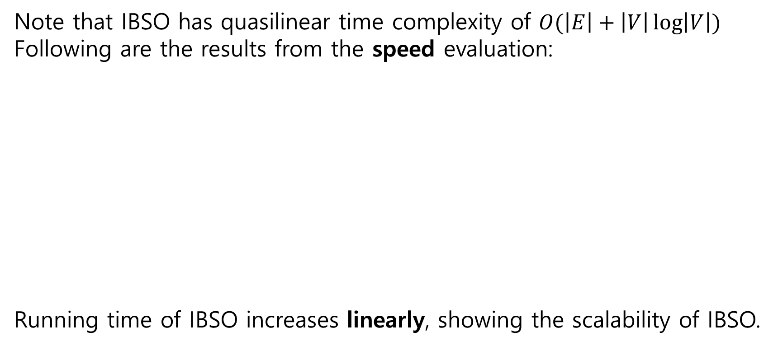
Experiments (2)
Note that IBSO has quasilinear time complexity of $O(\left|E\right|+\left|V\right|\log\left|V\right|)$
Following are the results from the speed evaluation:
Running time of IBSO increases linearly, showing the scalability of IBSO.
Linearly increase

Slide 16
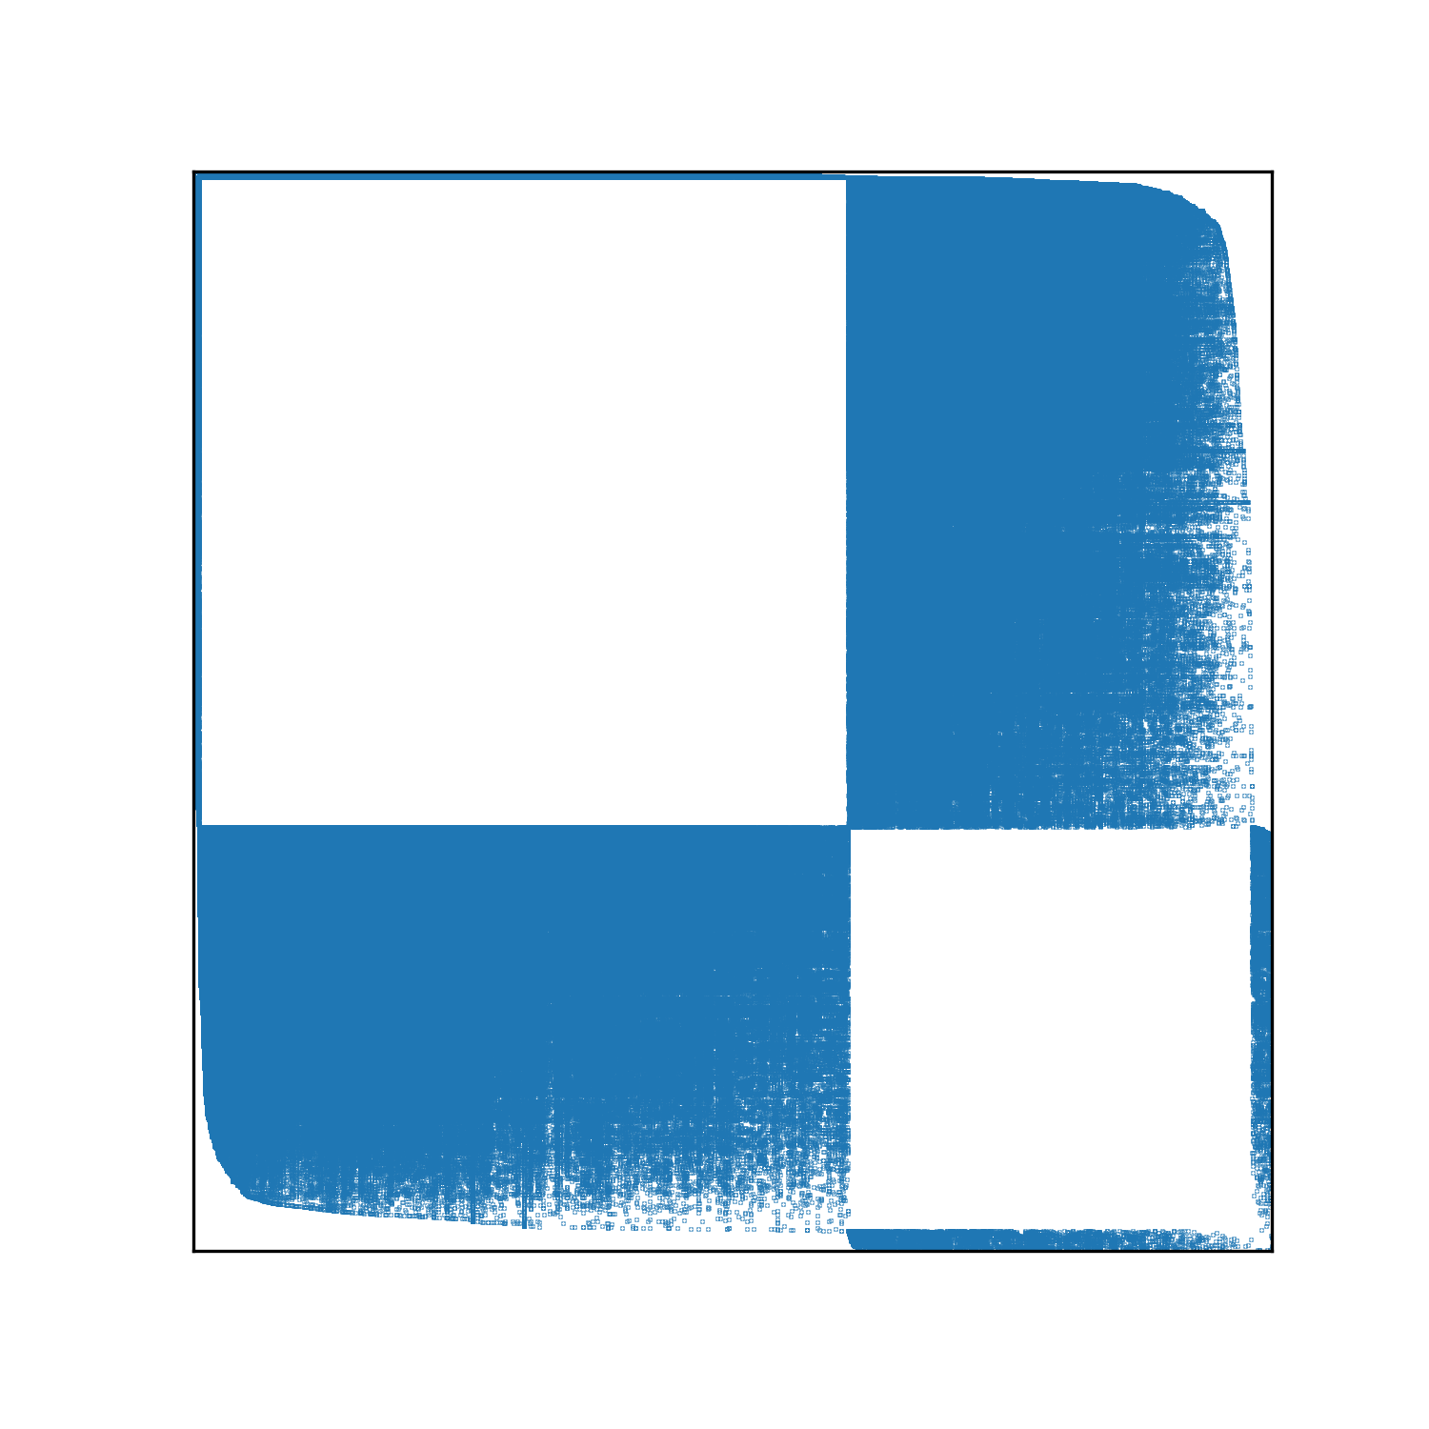
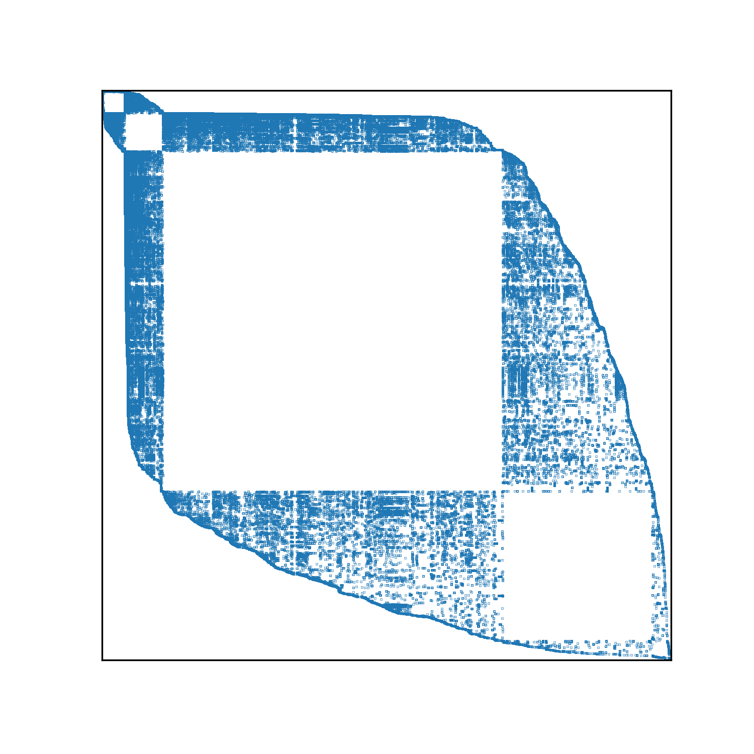
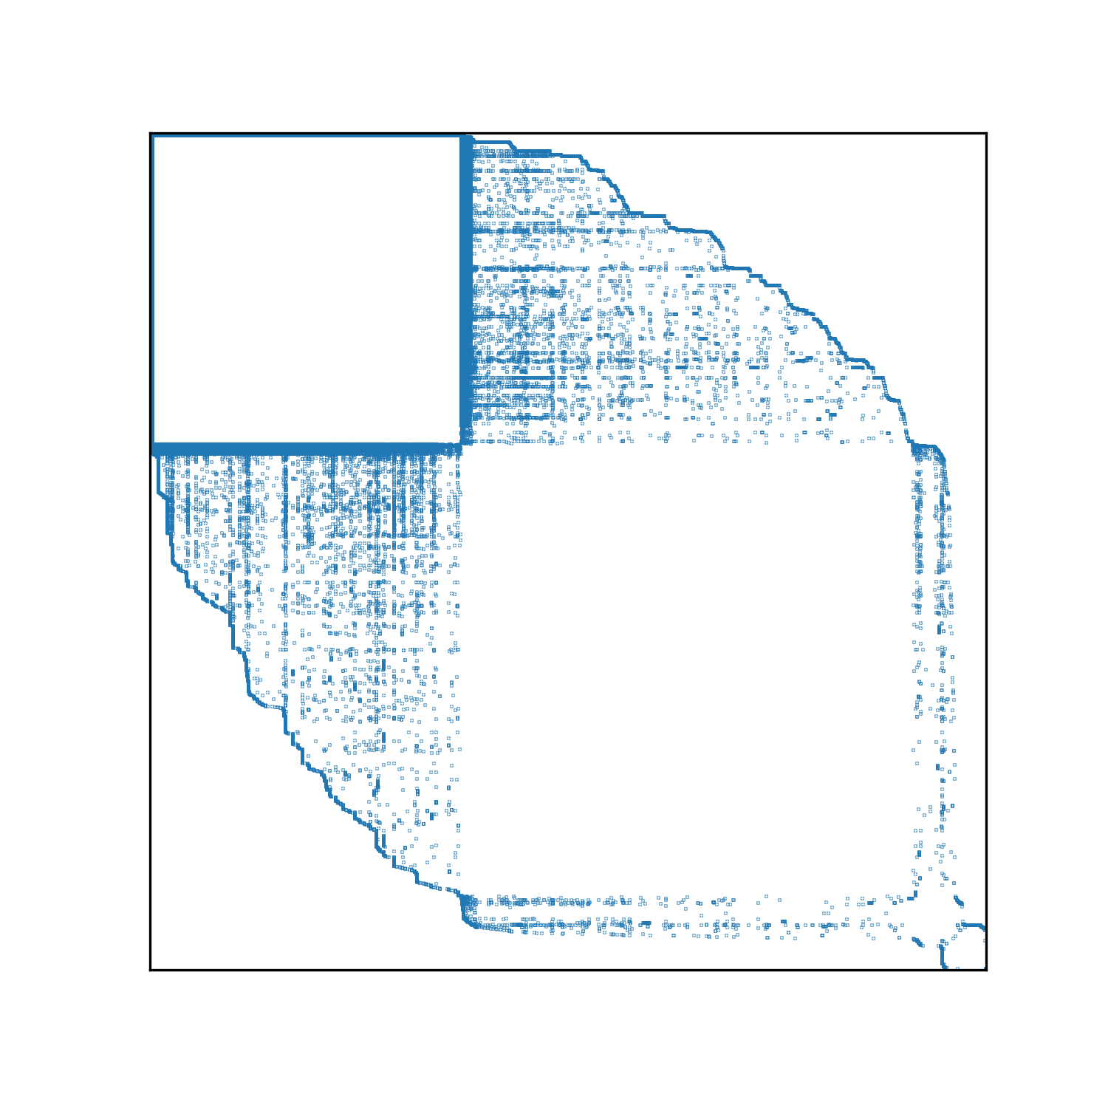
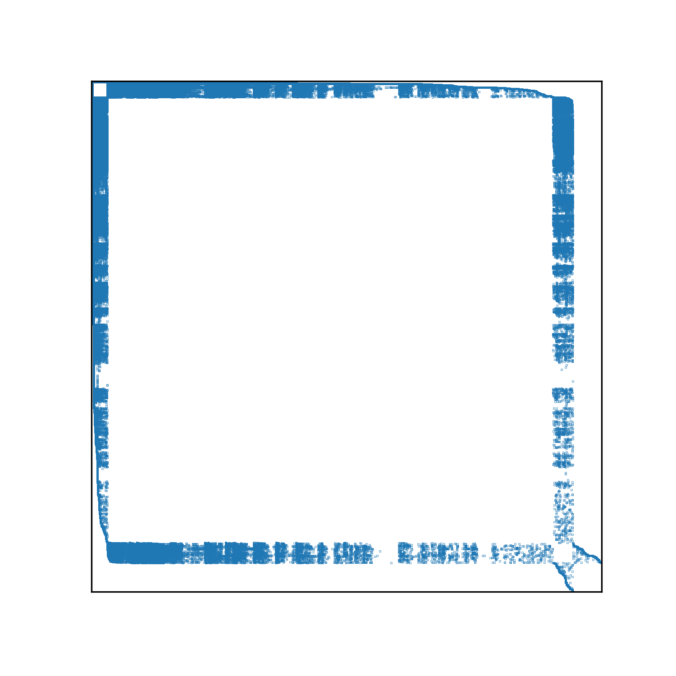
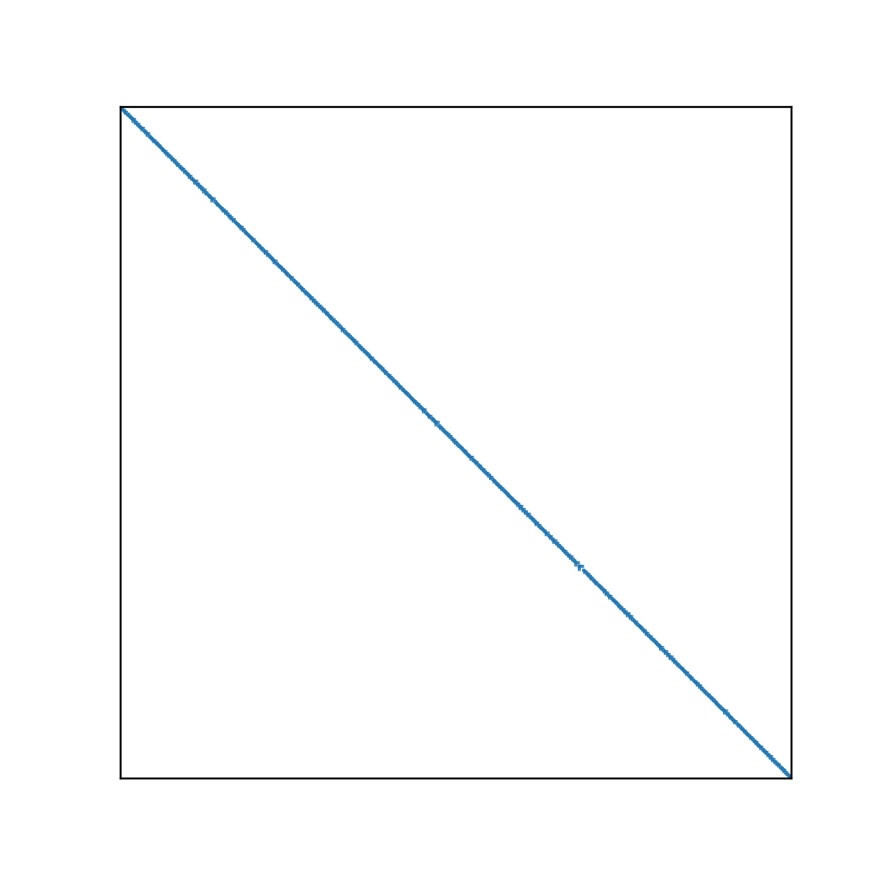
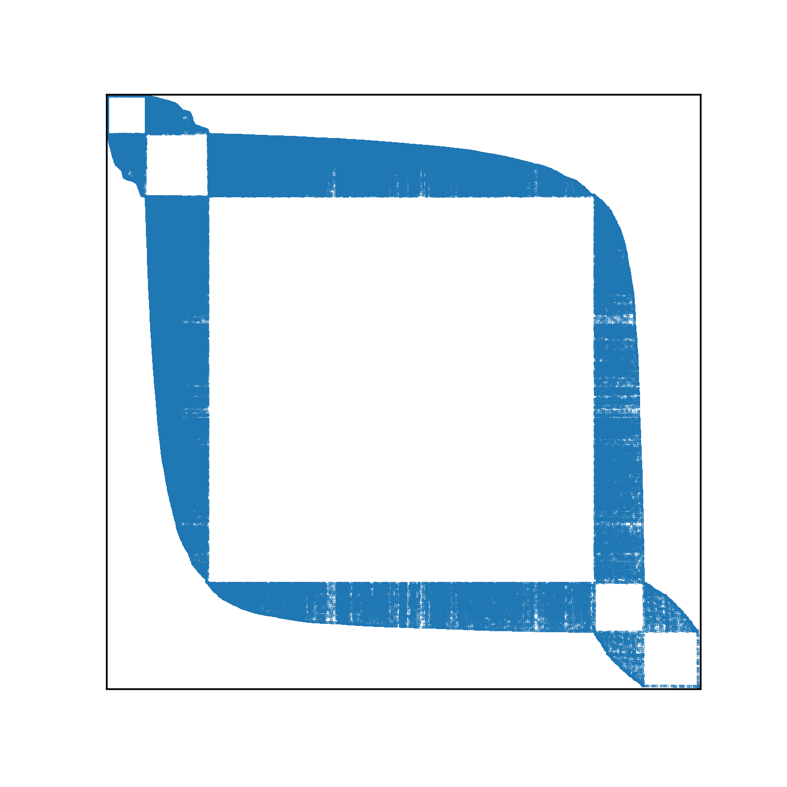
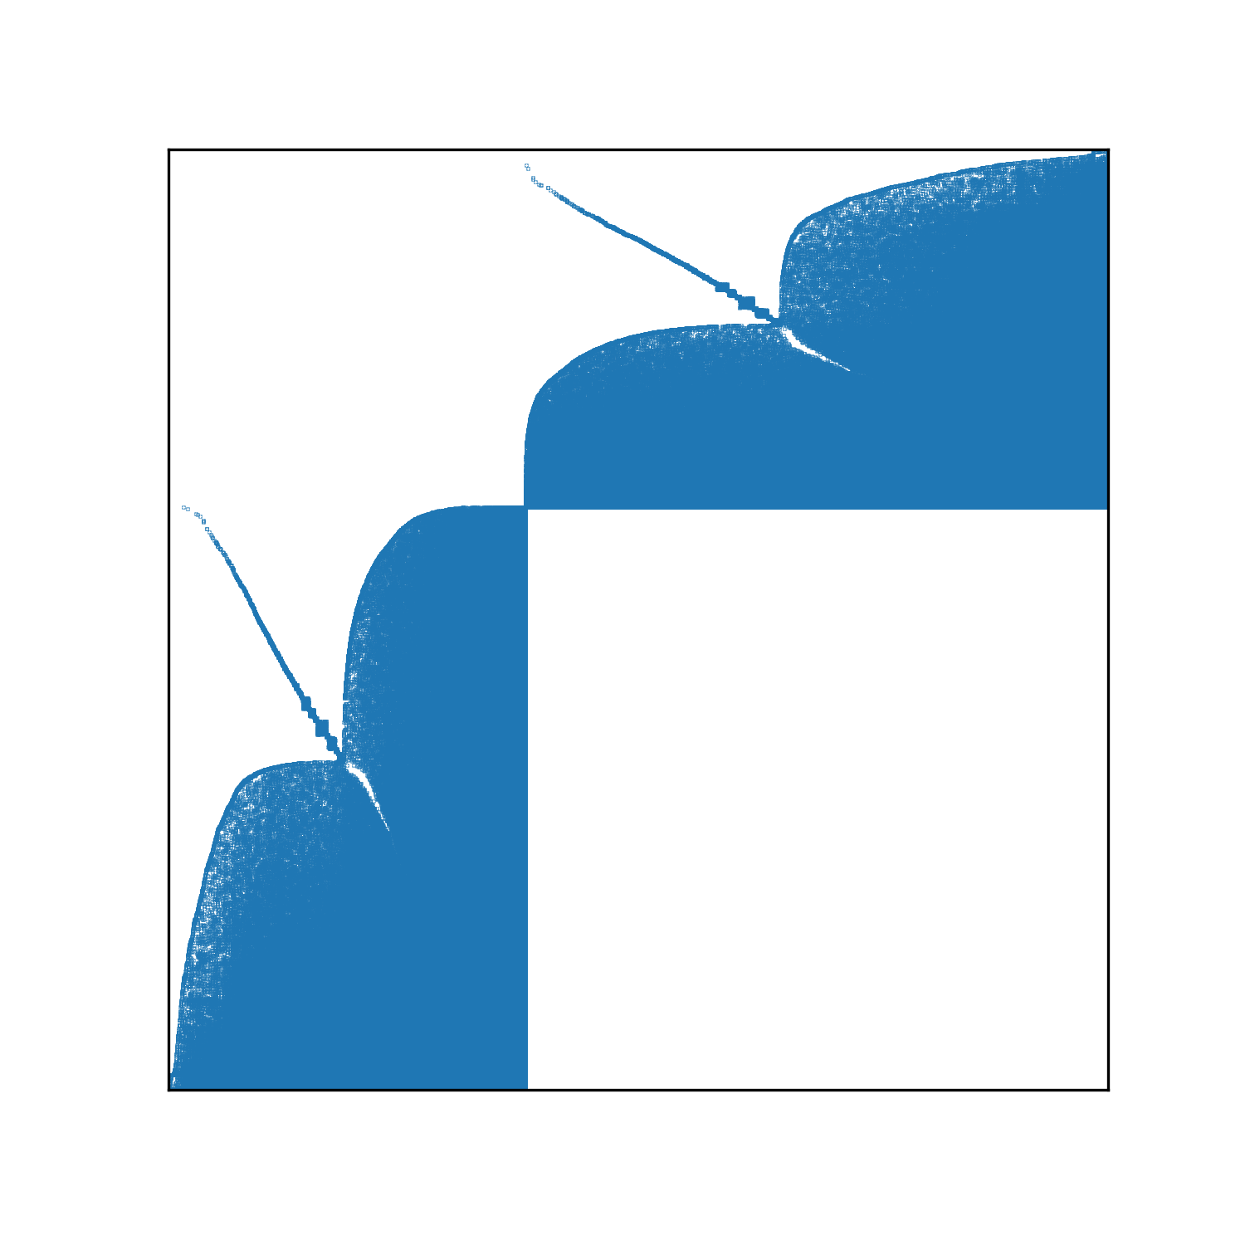
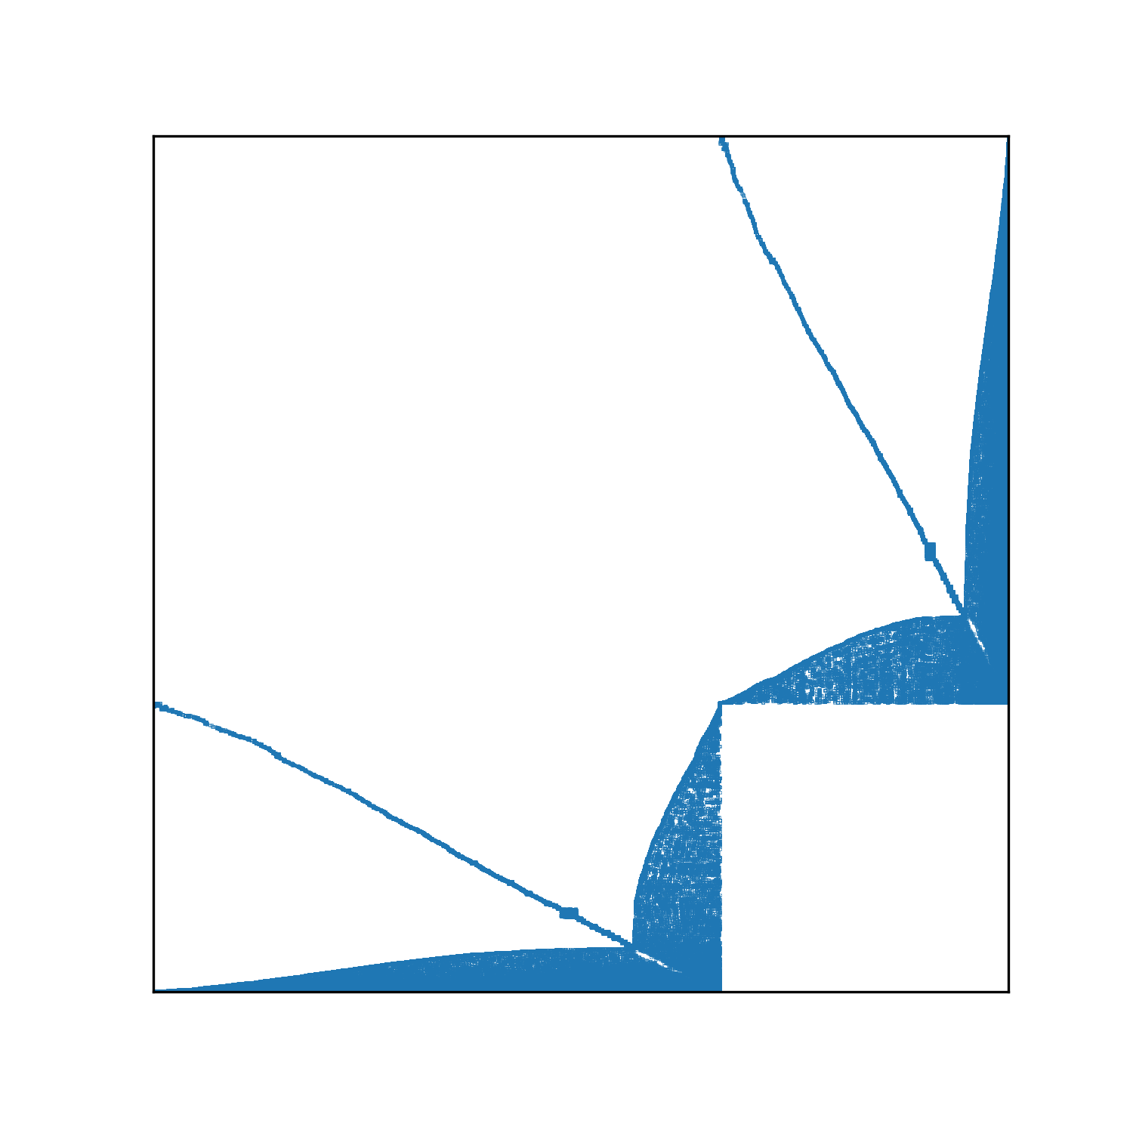
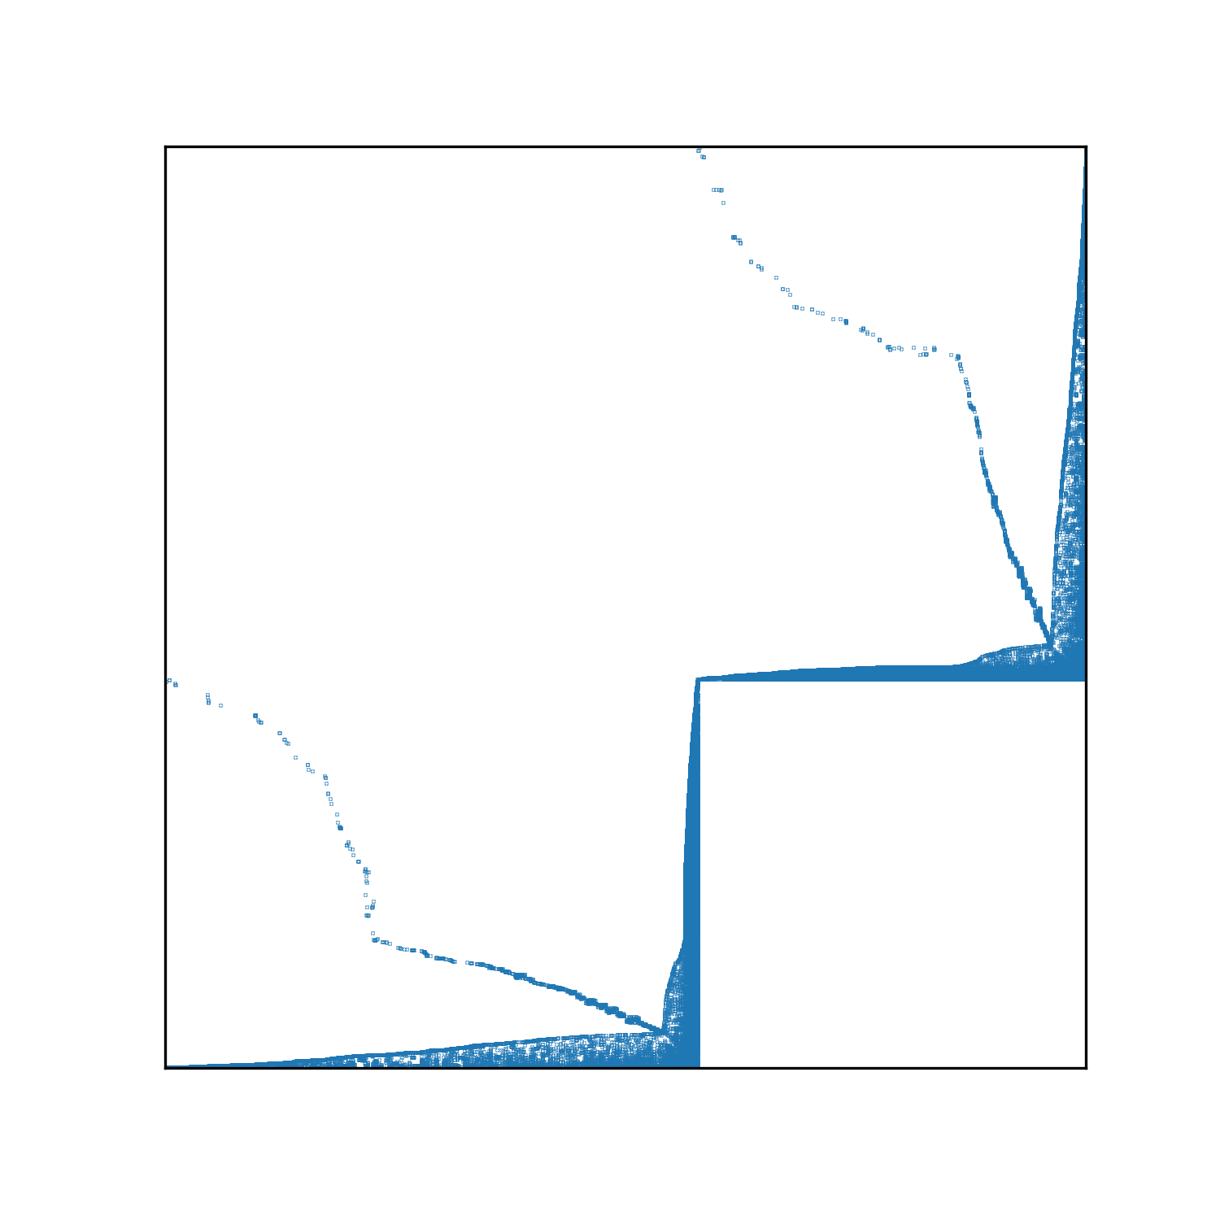
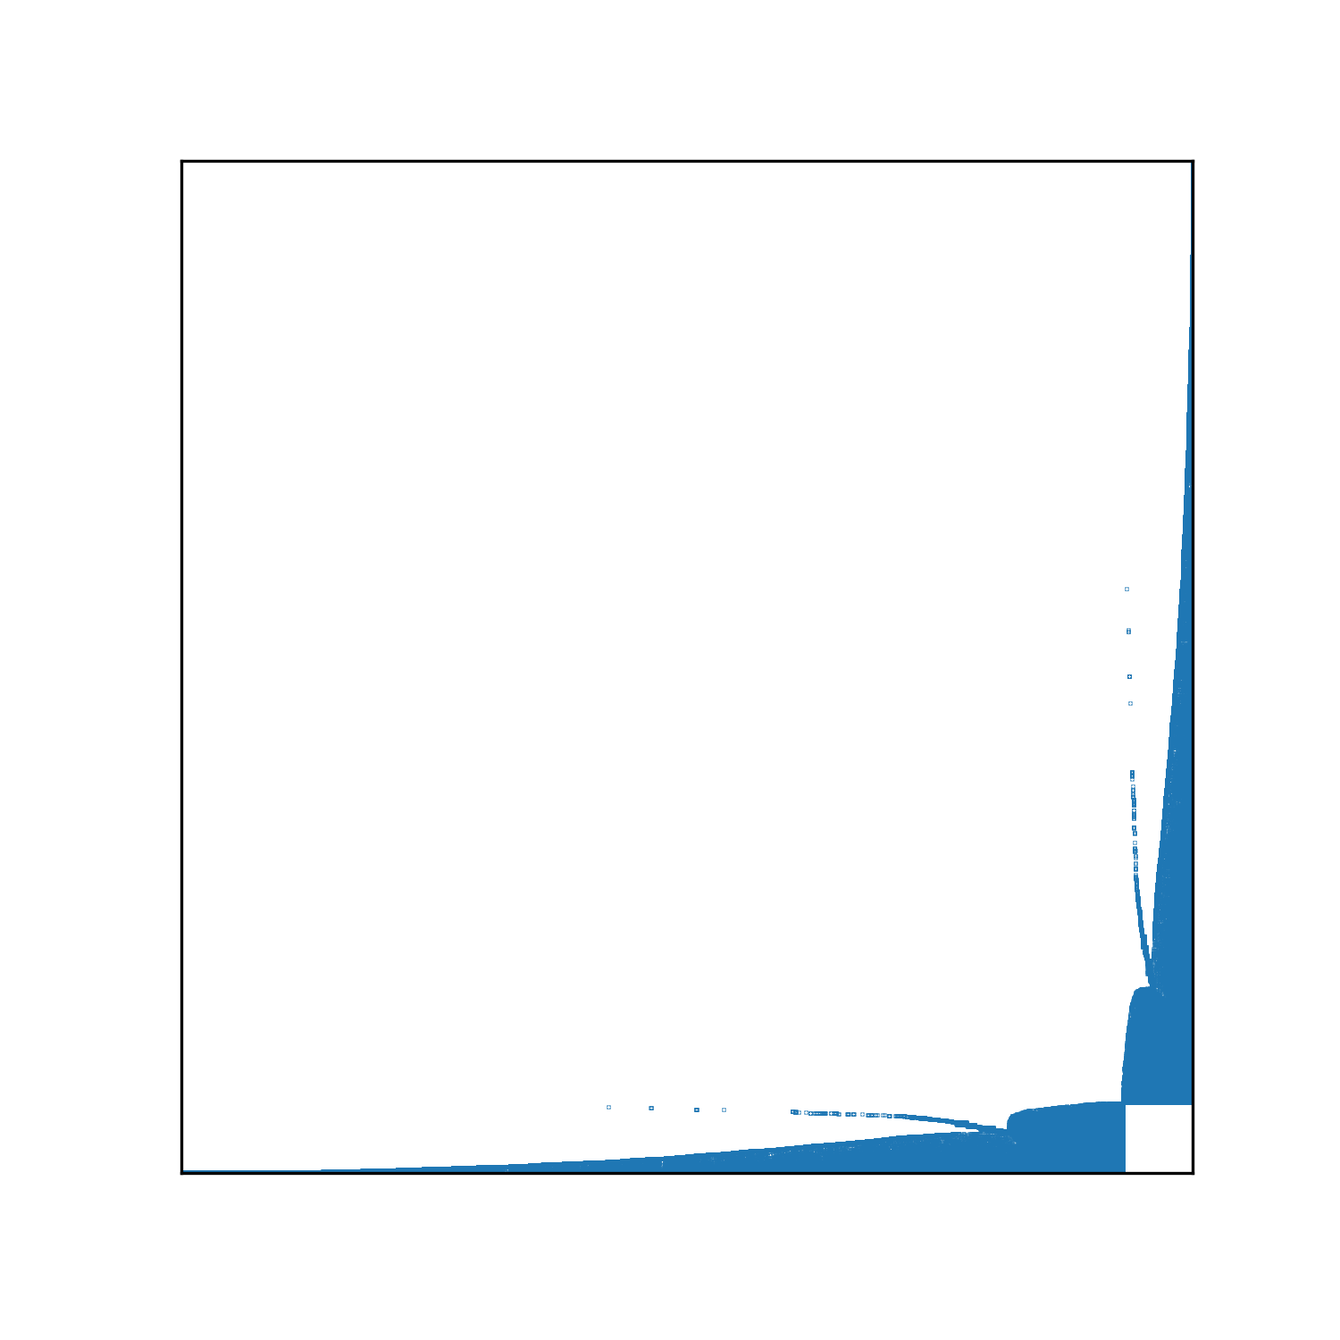
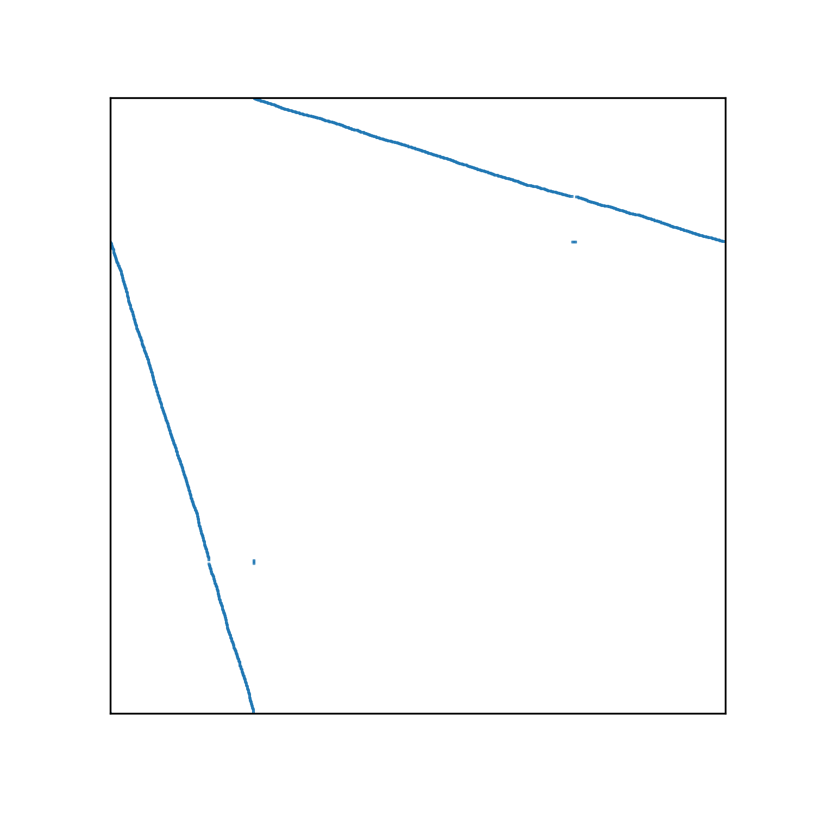
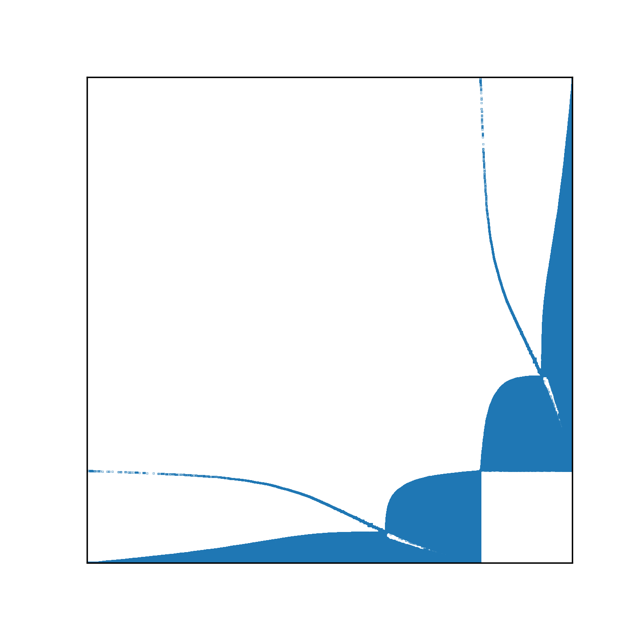
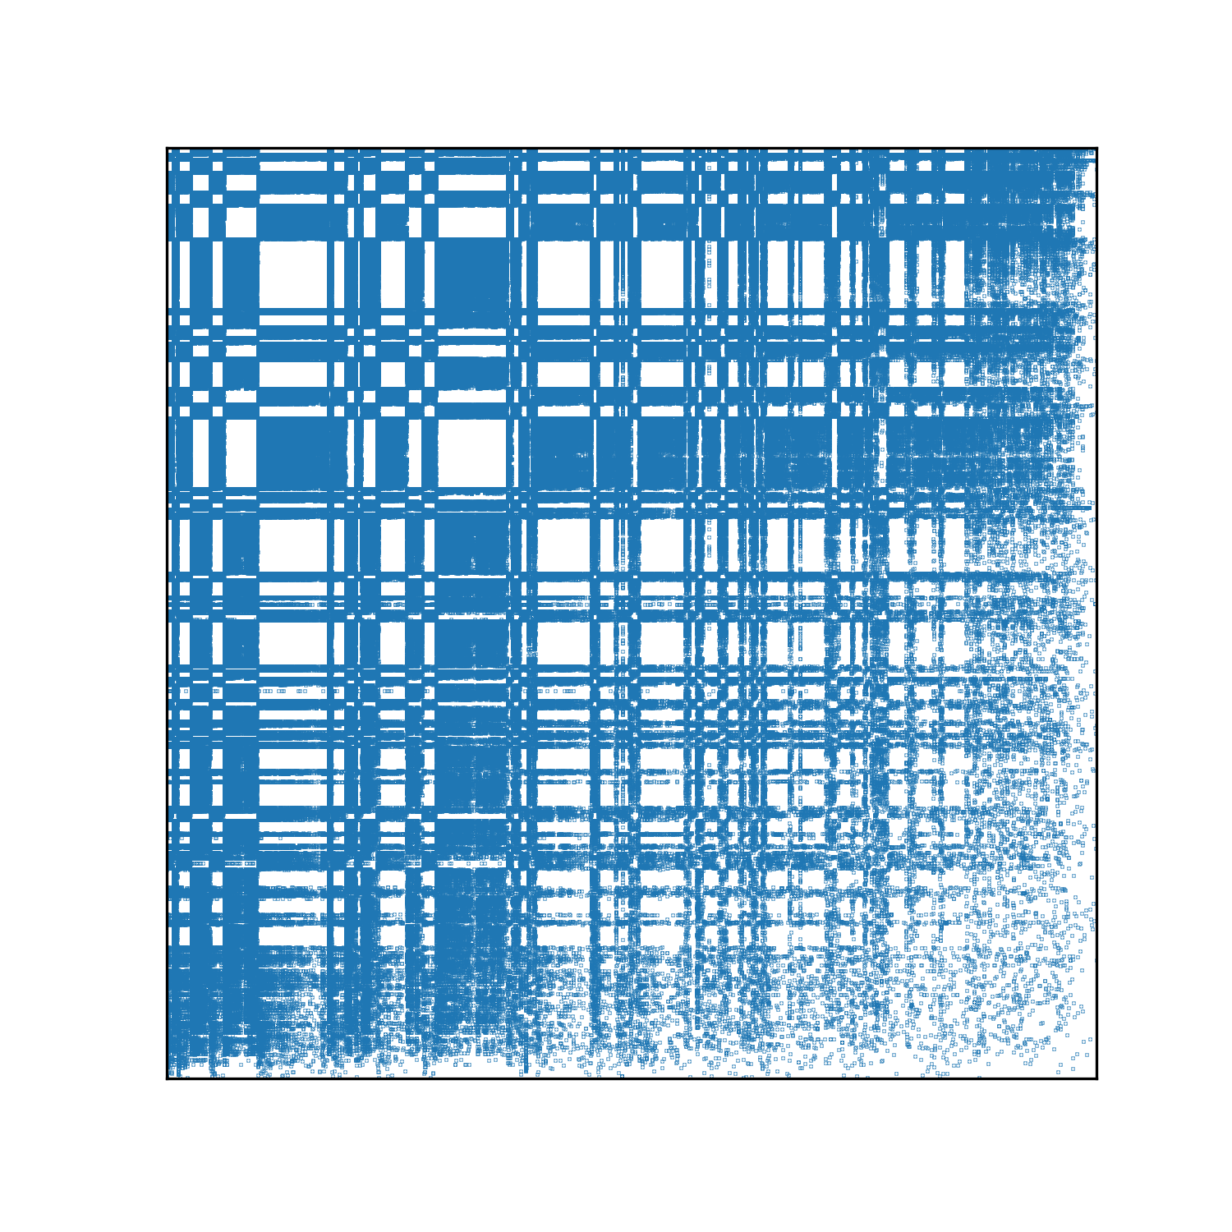
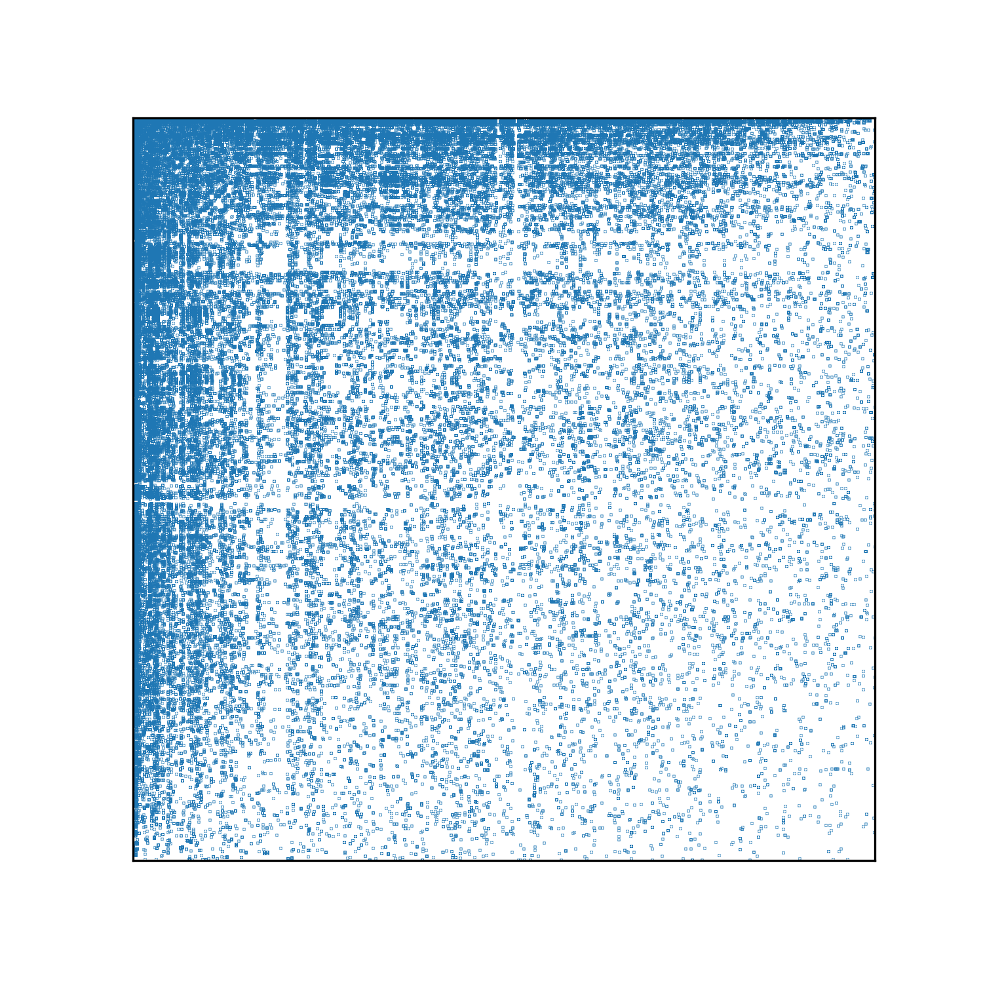
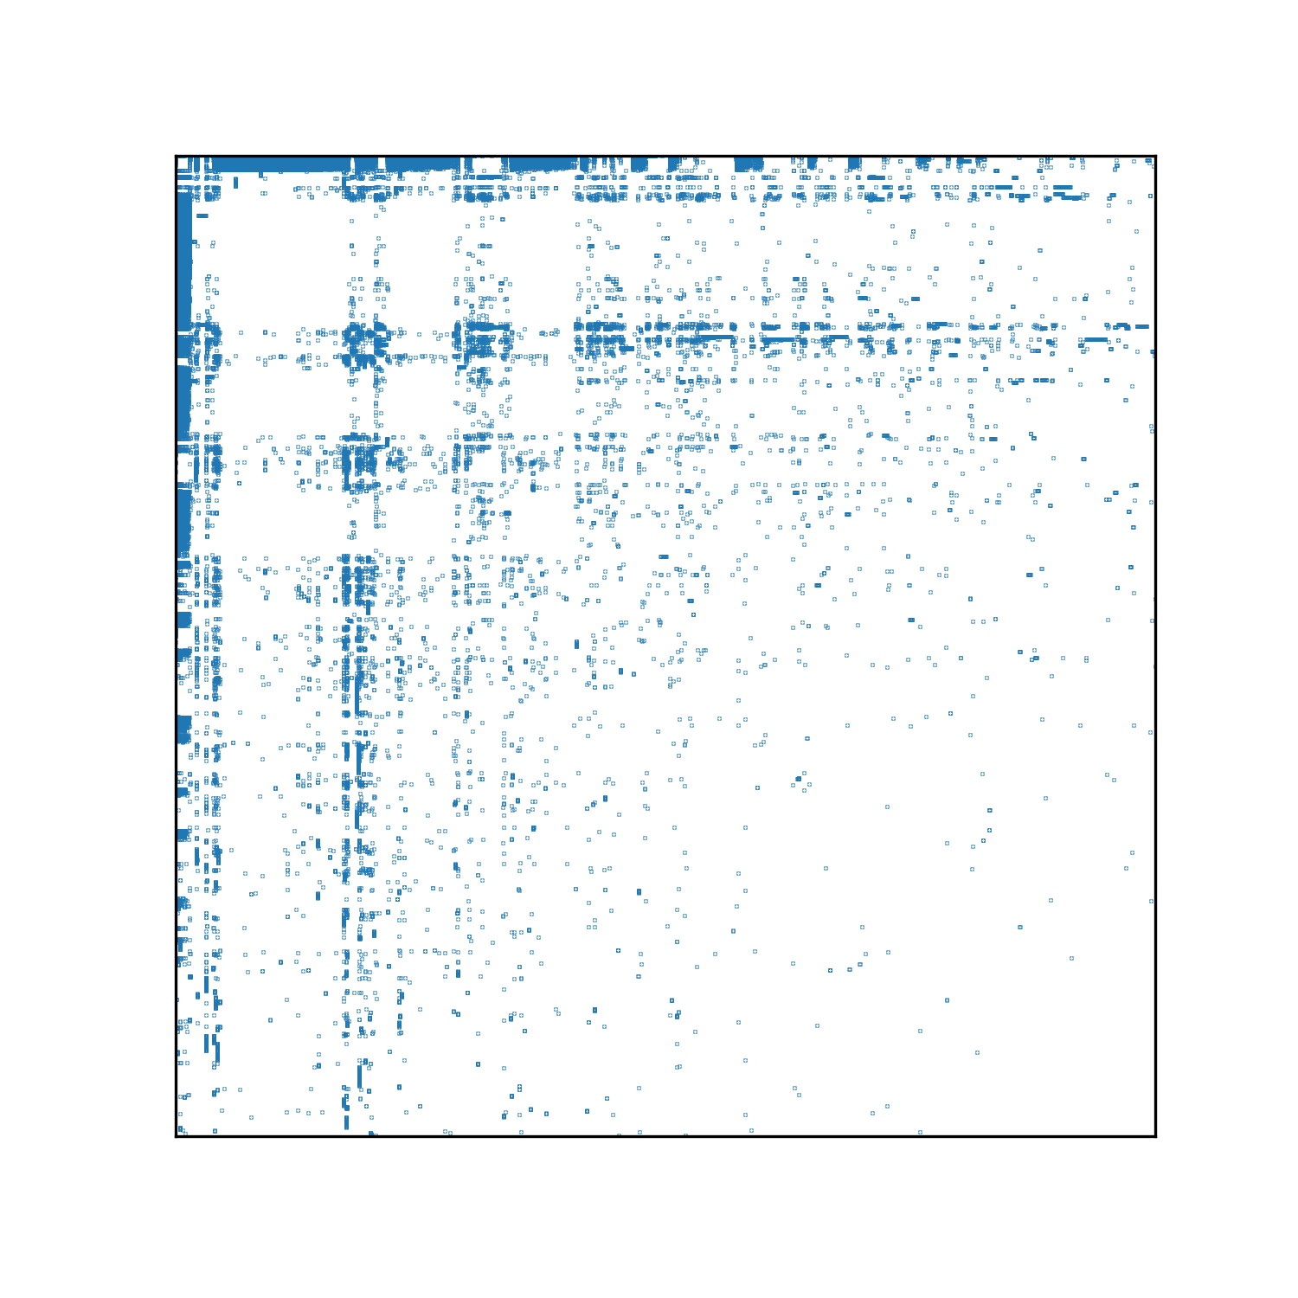
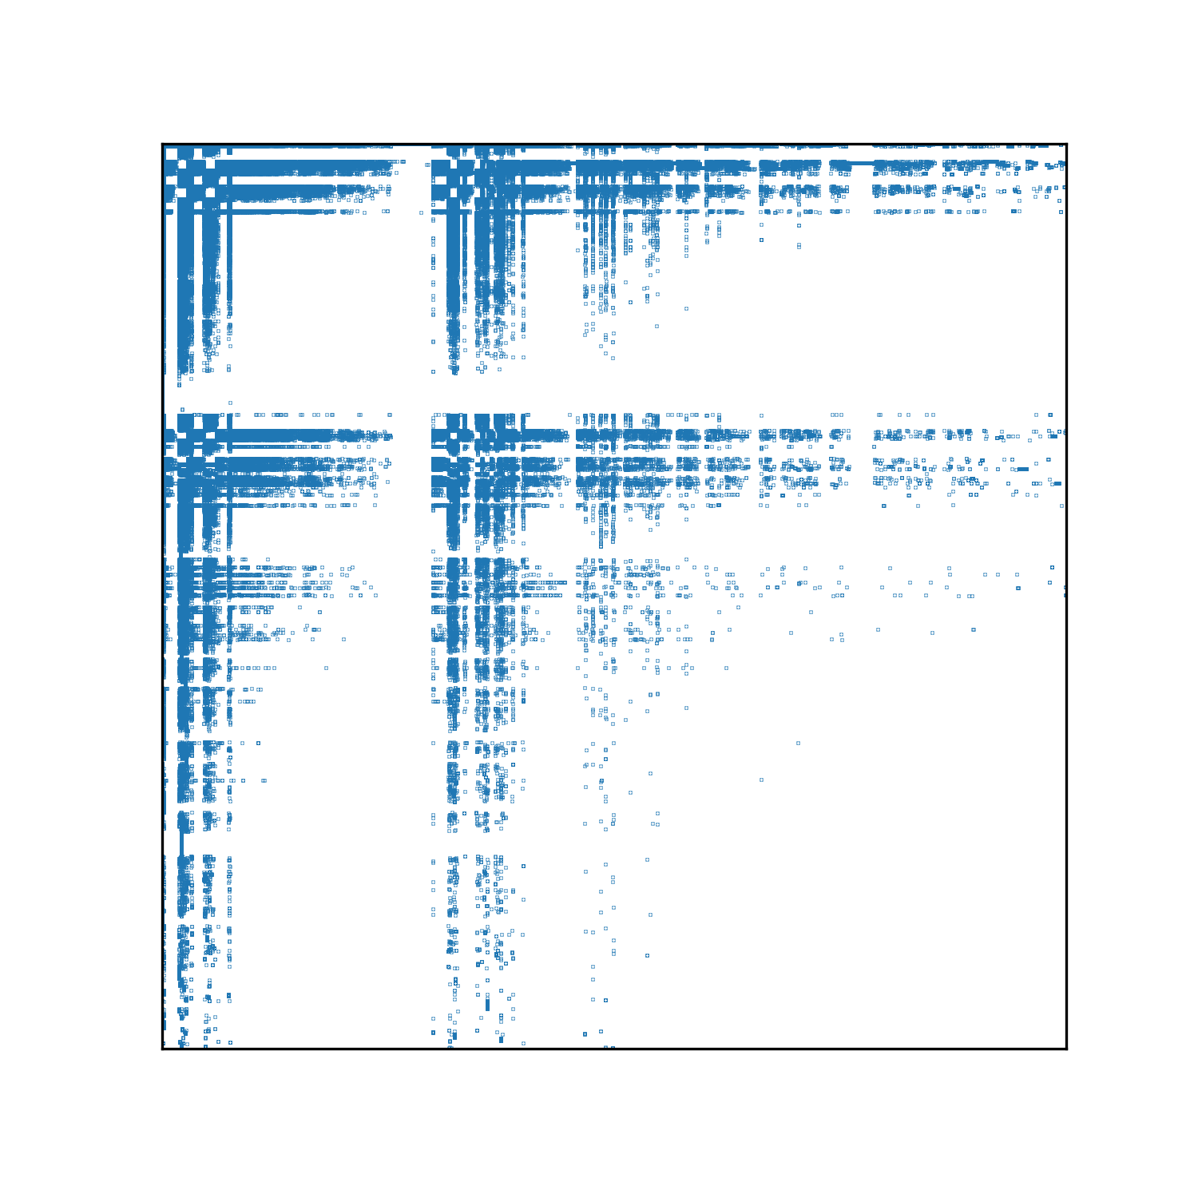
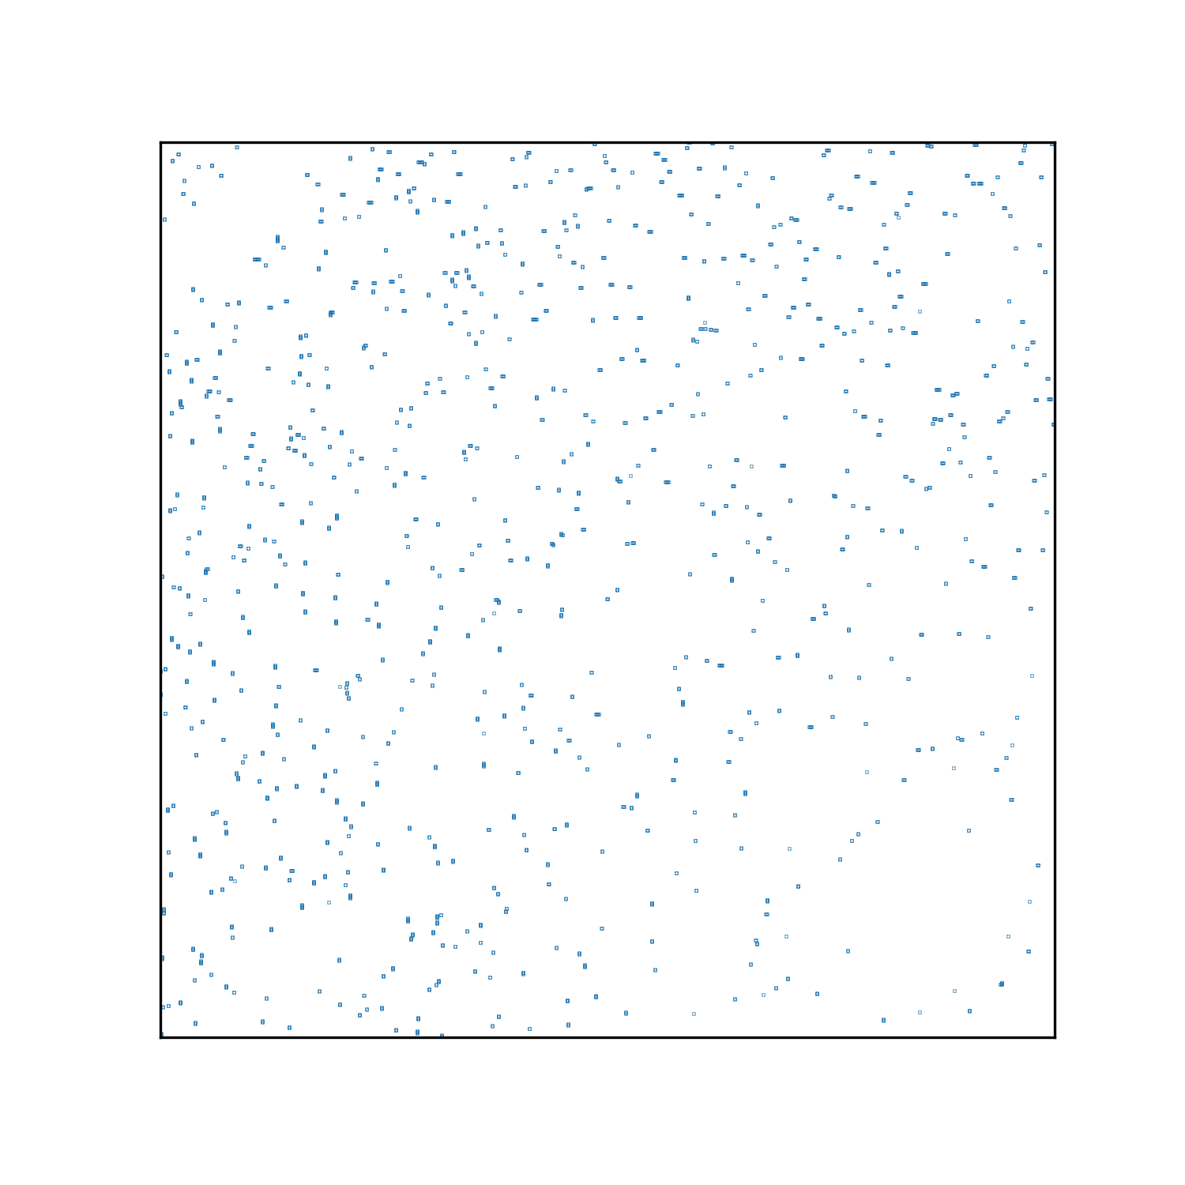
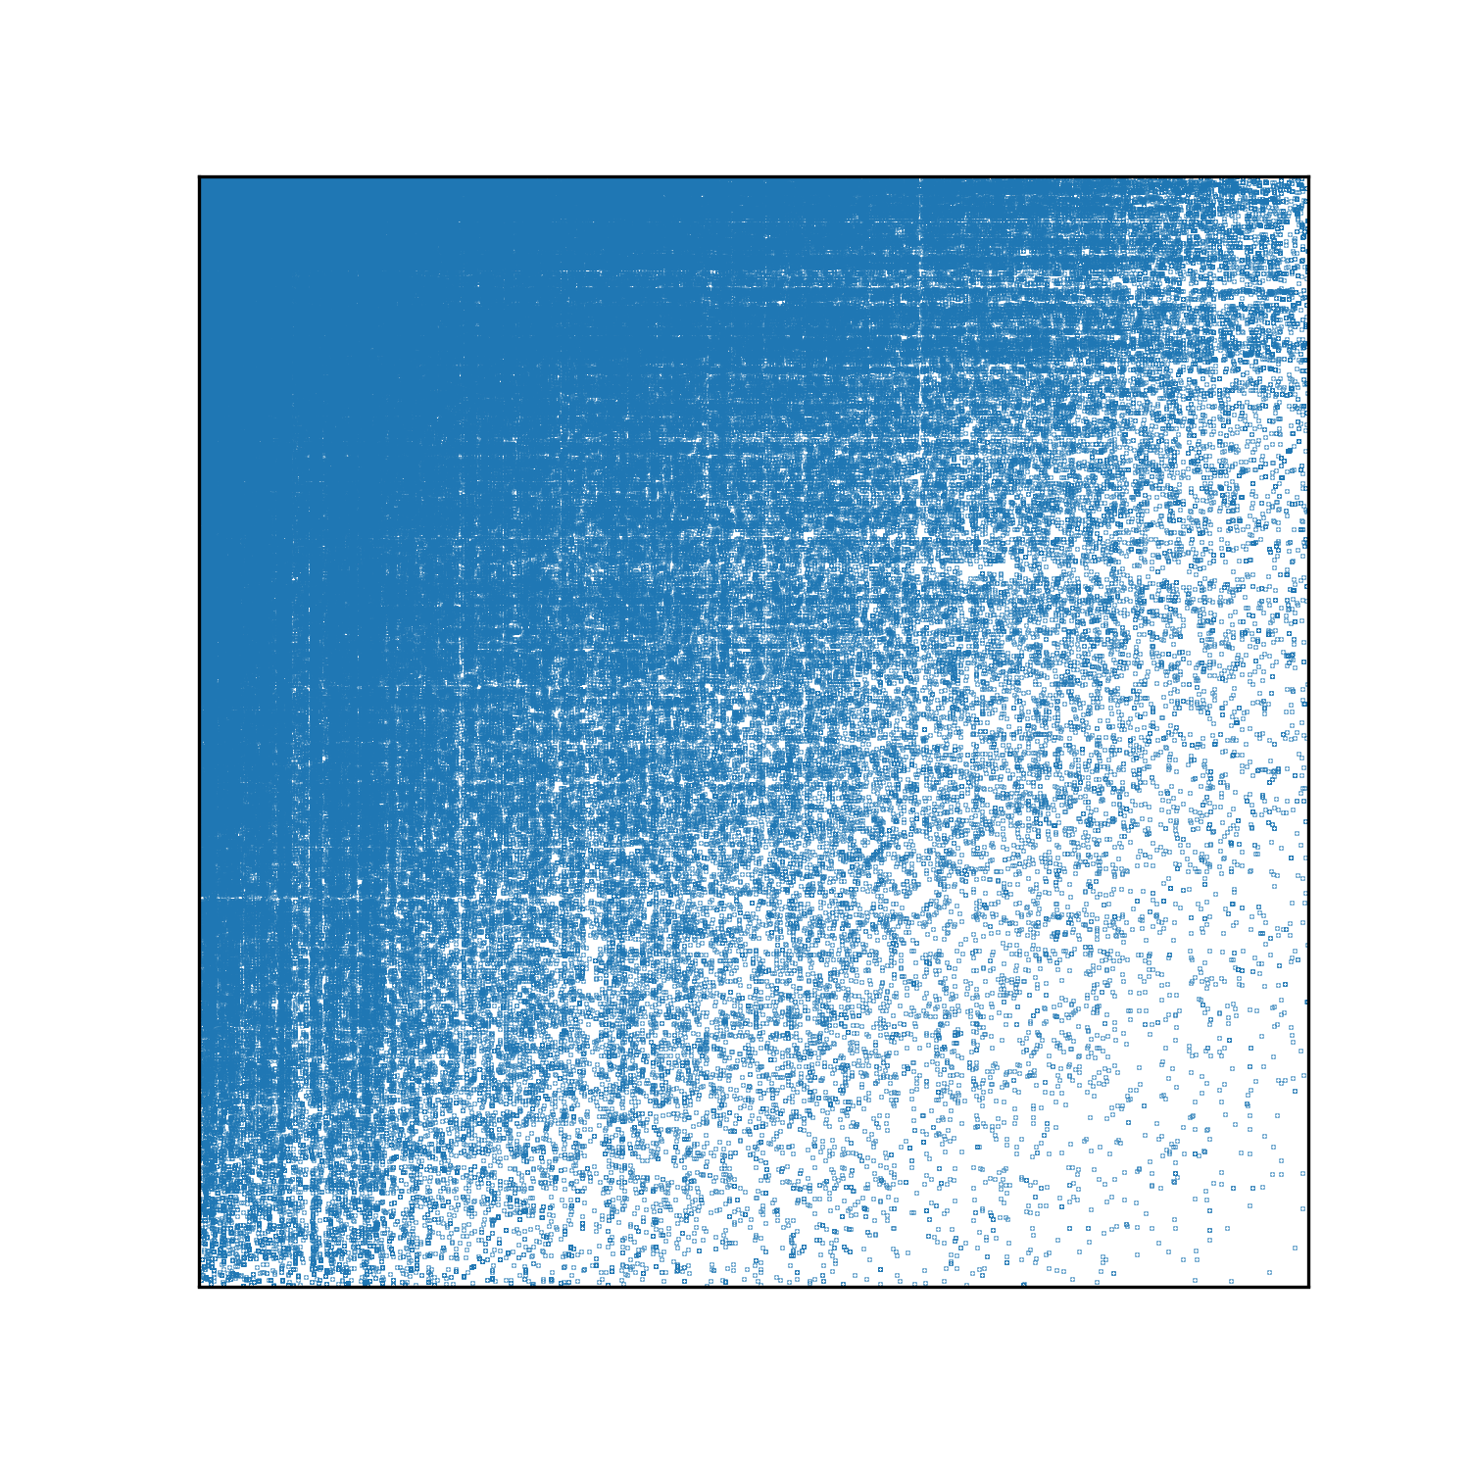
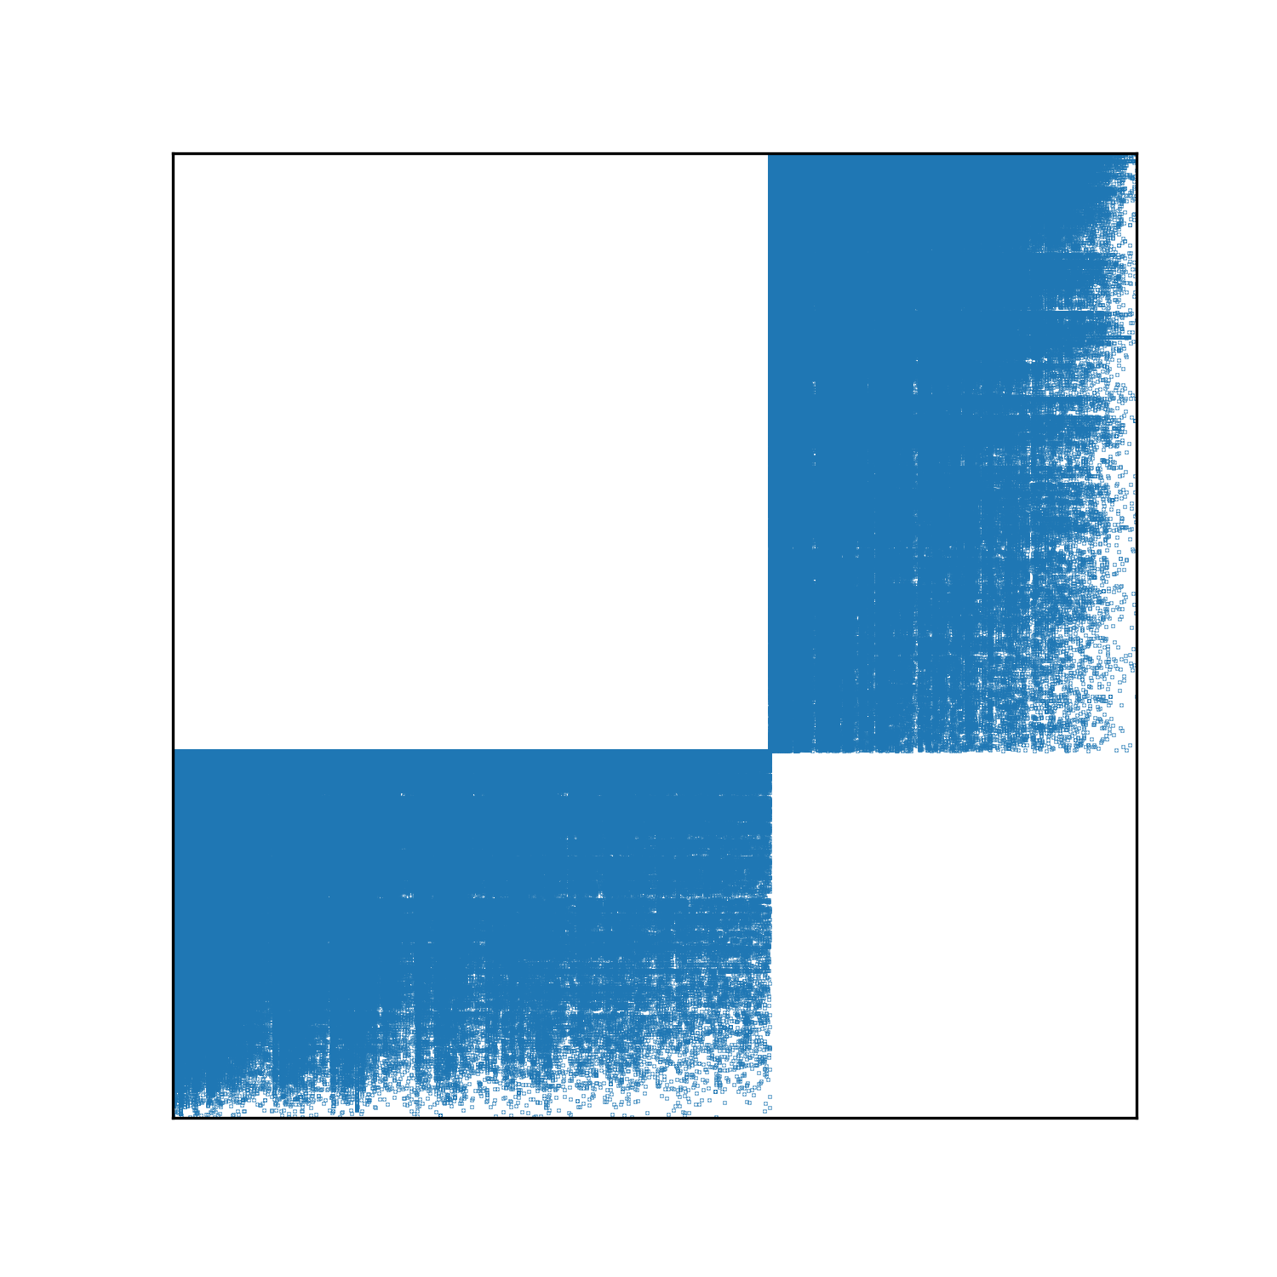
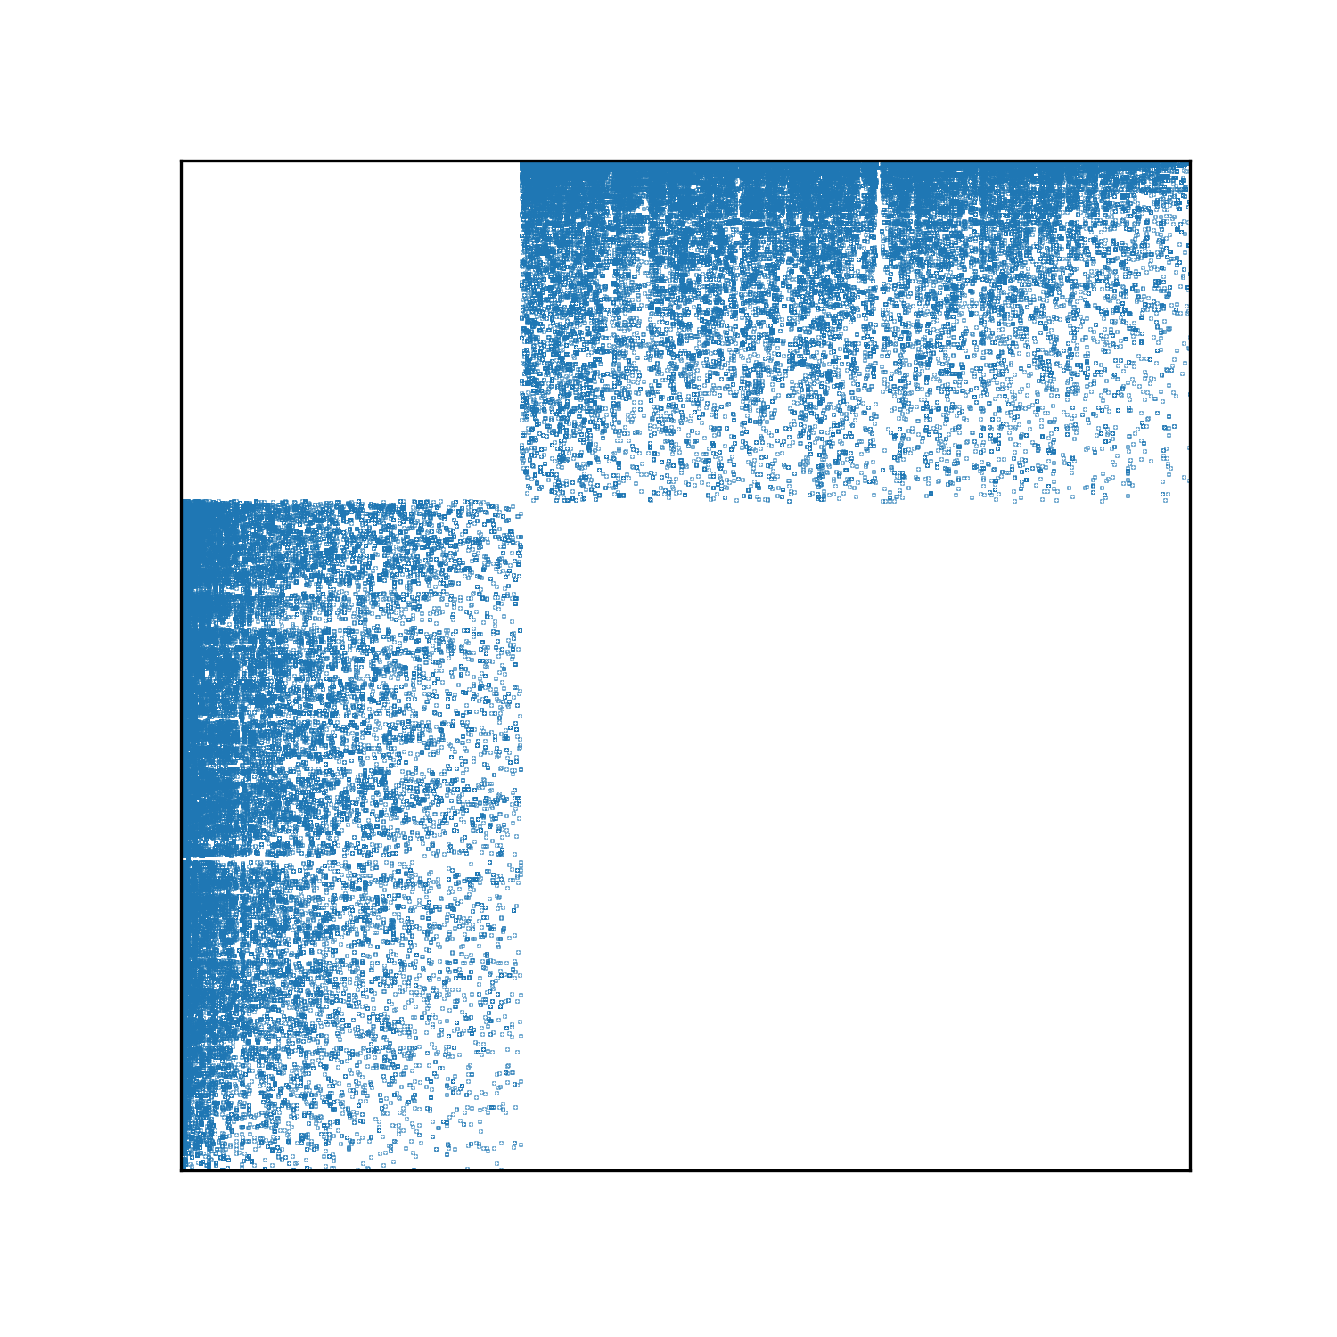
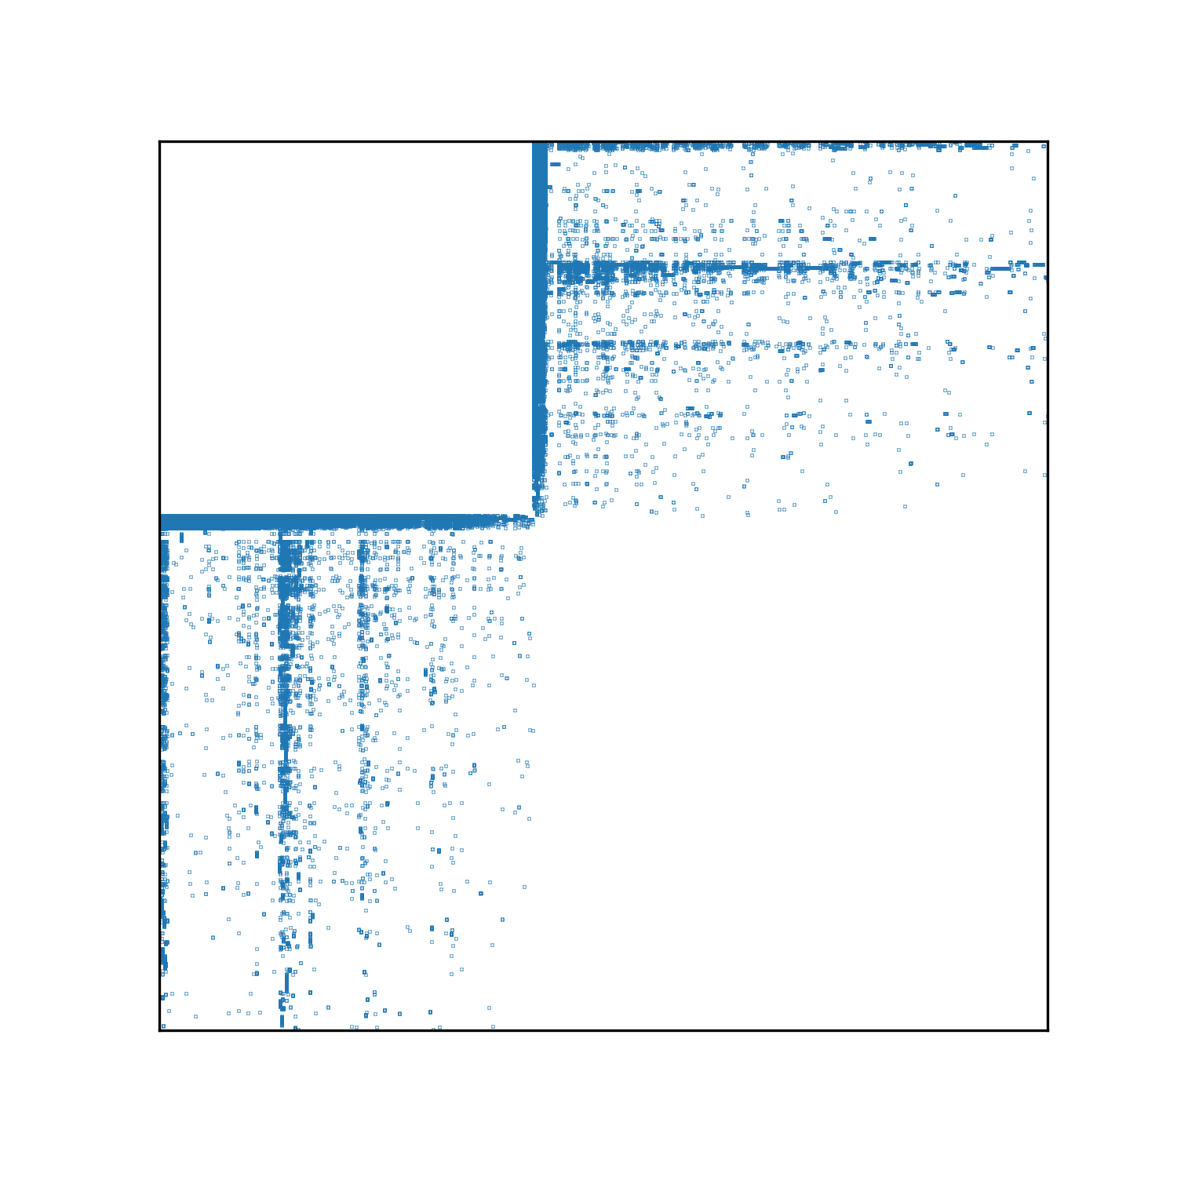
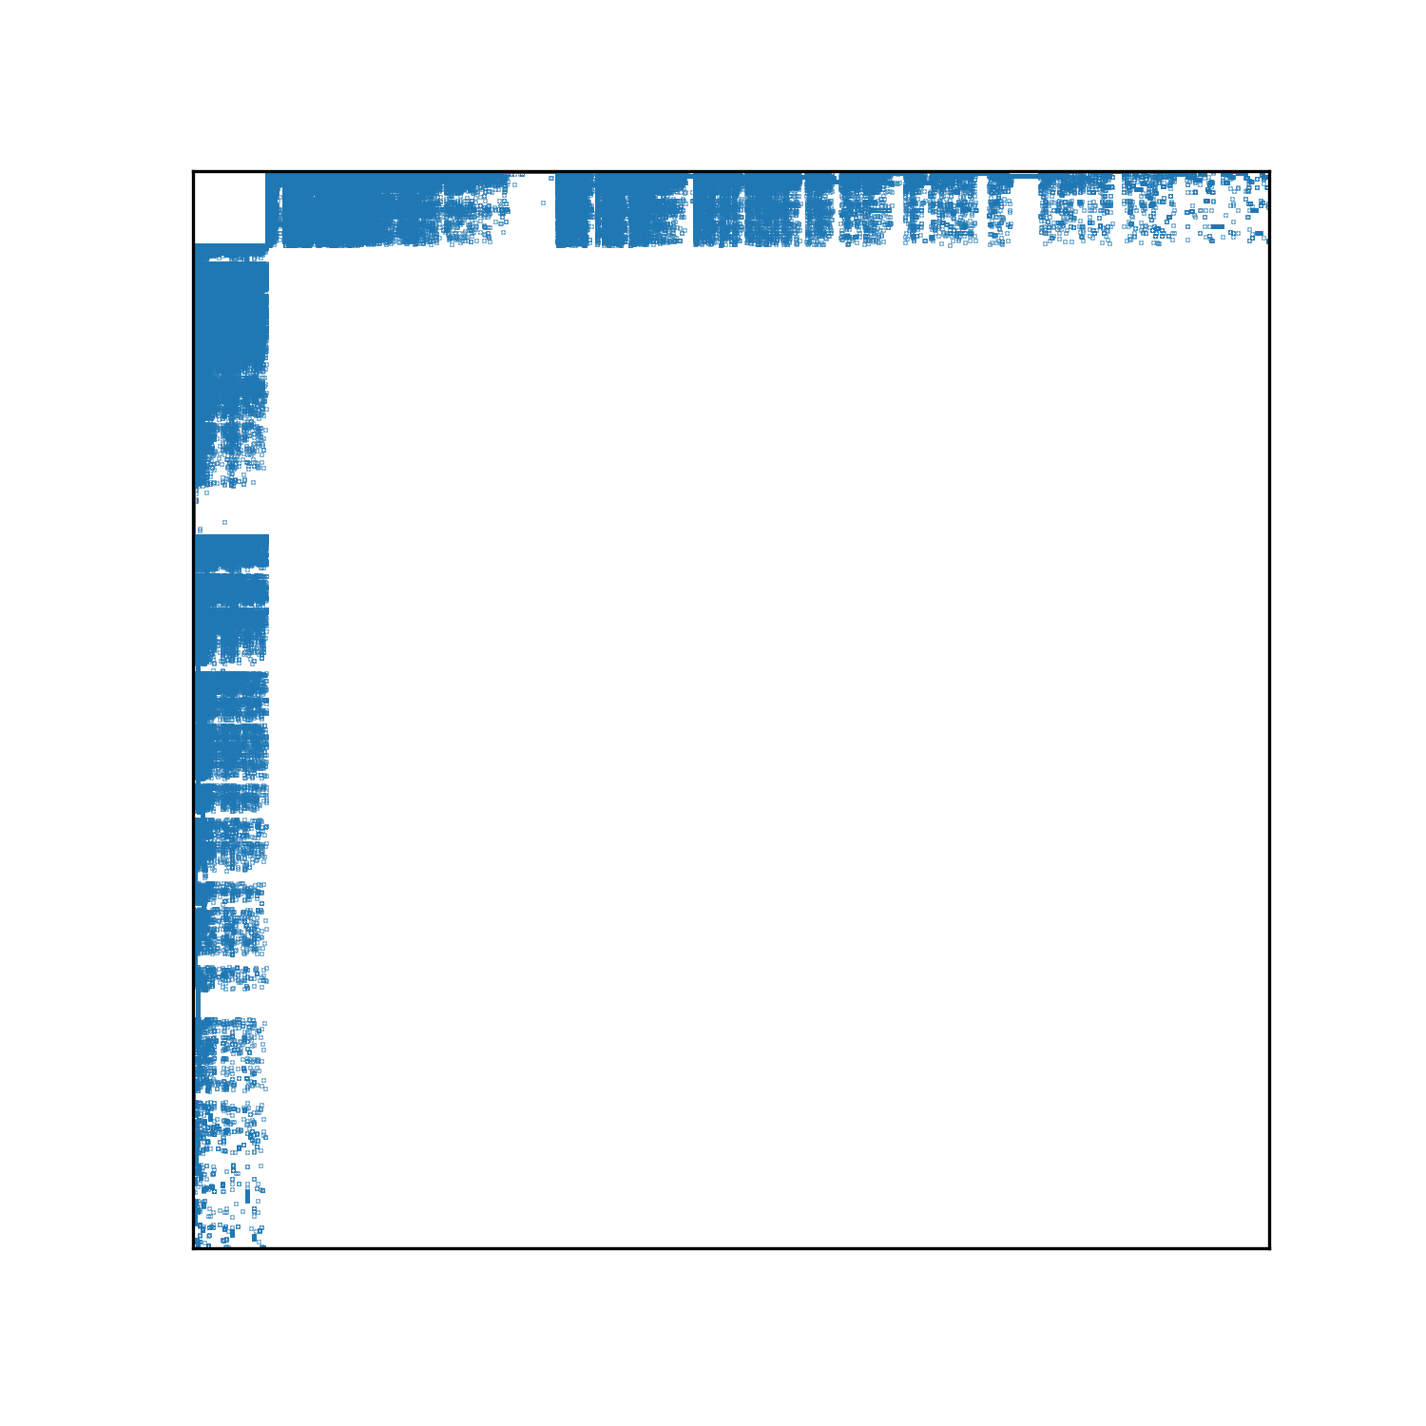
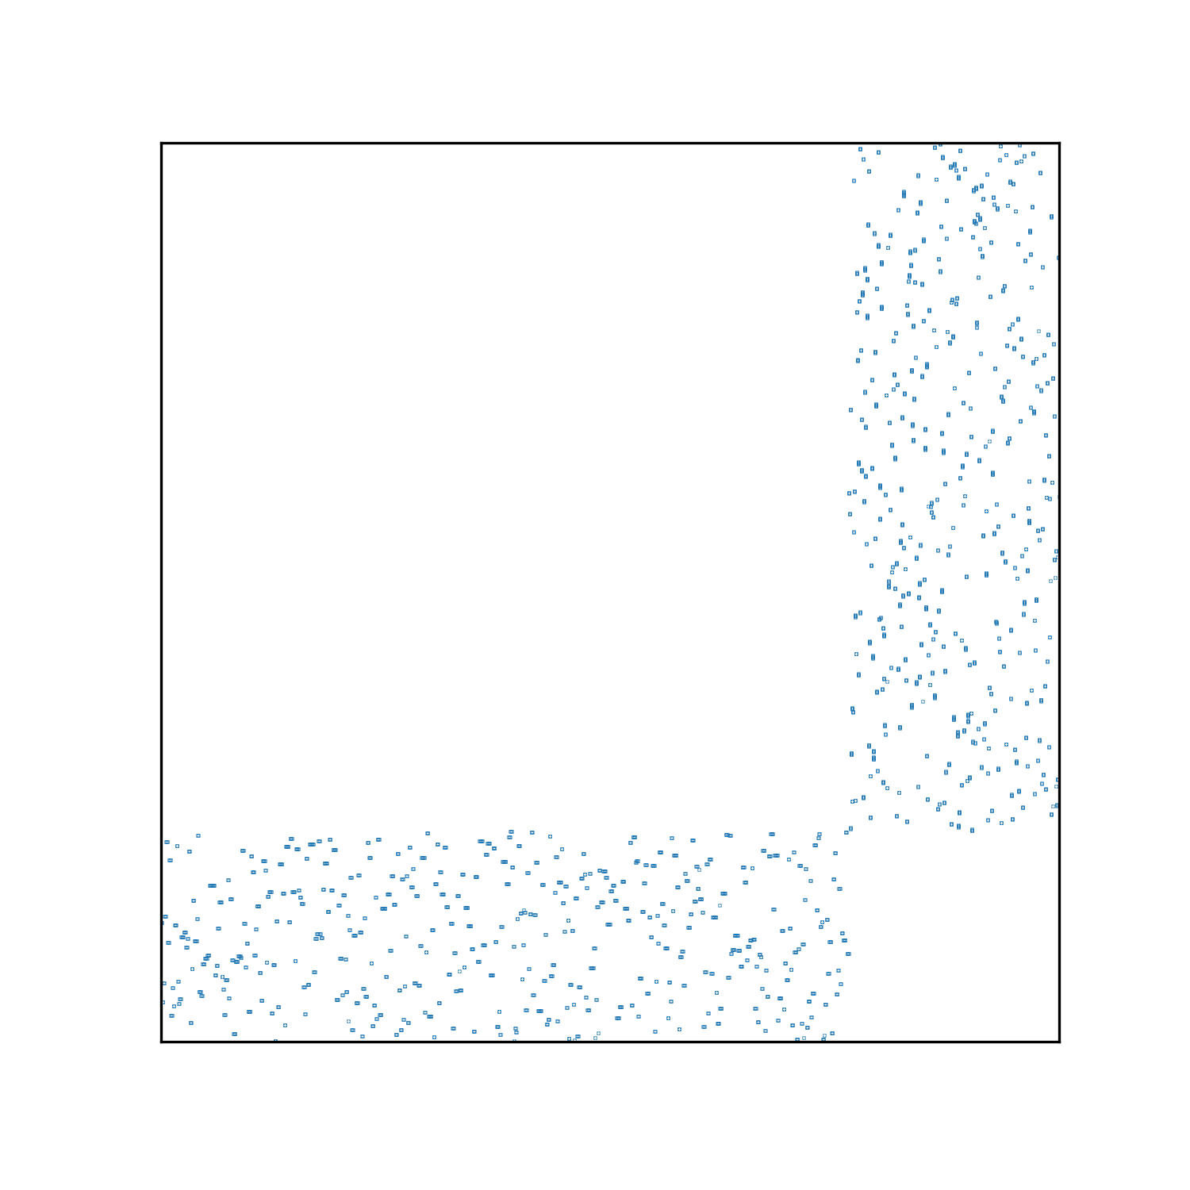
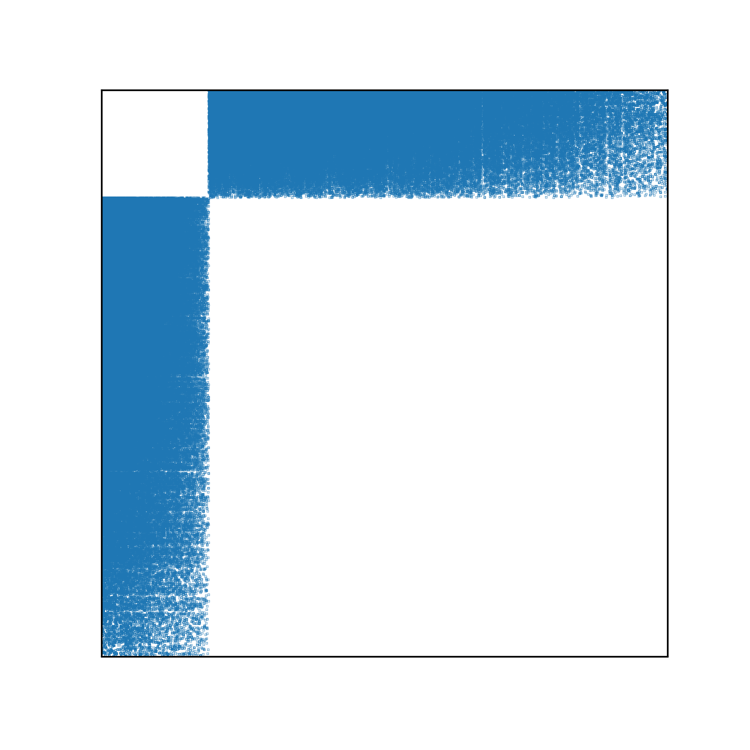
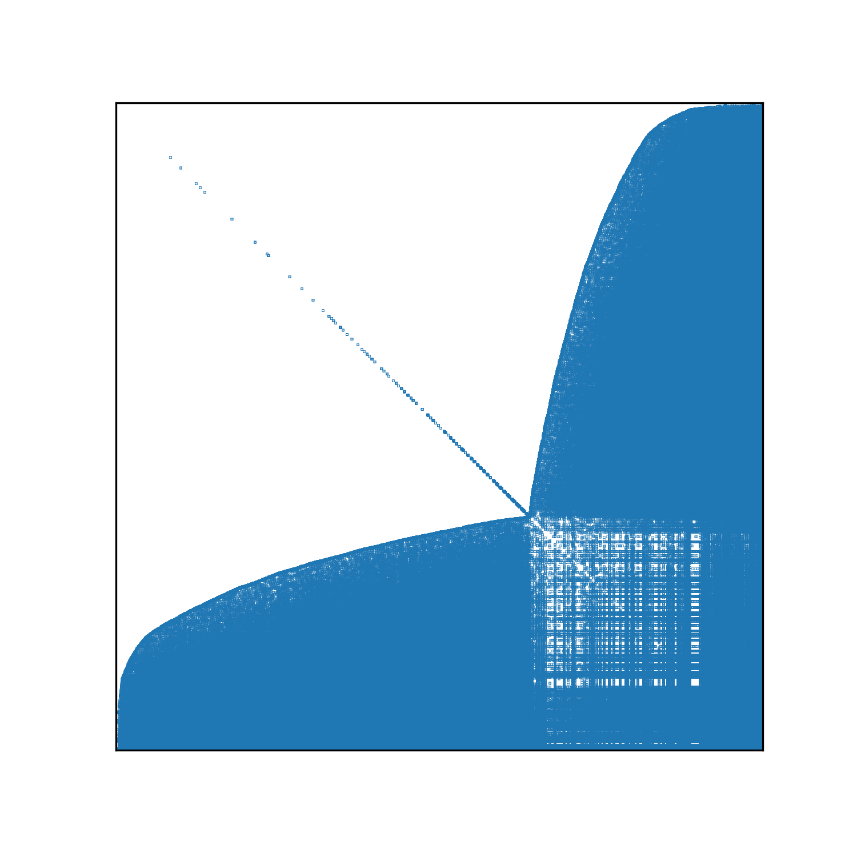
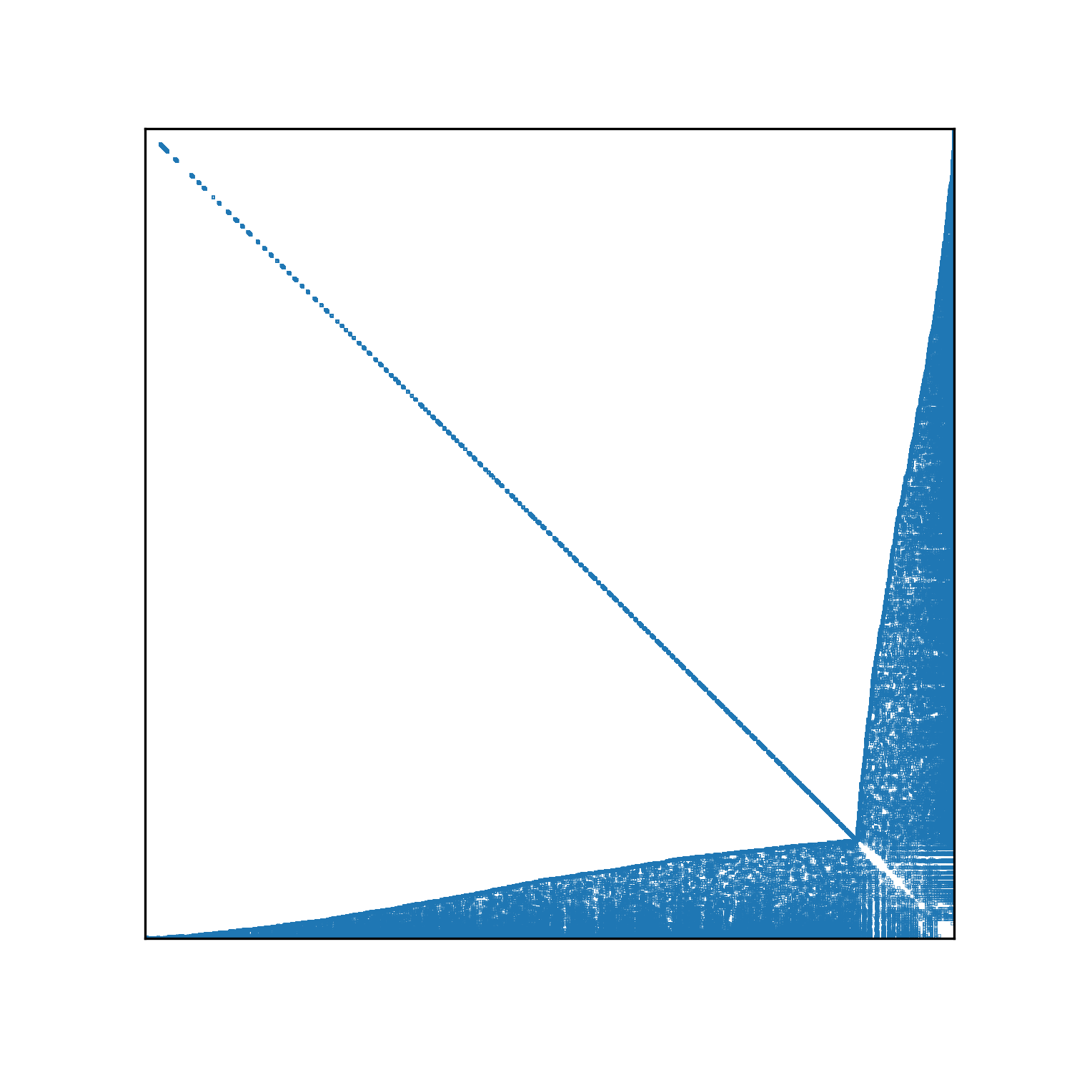
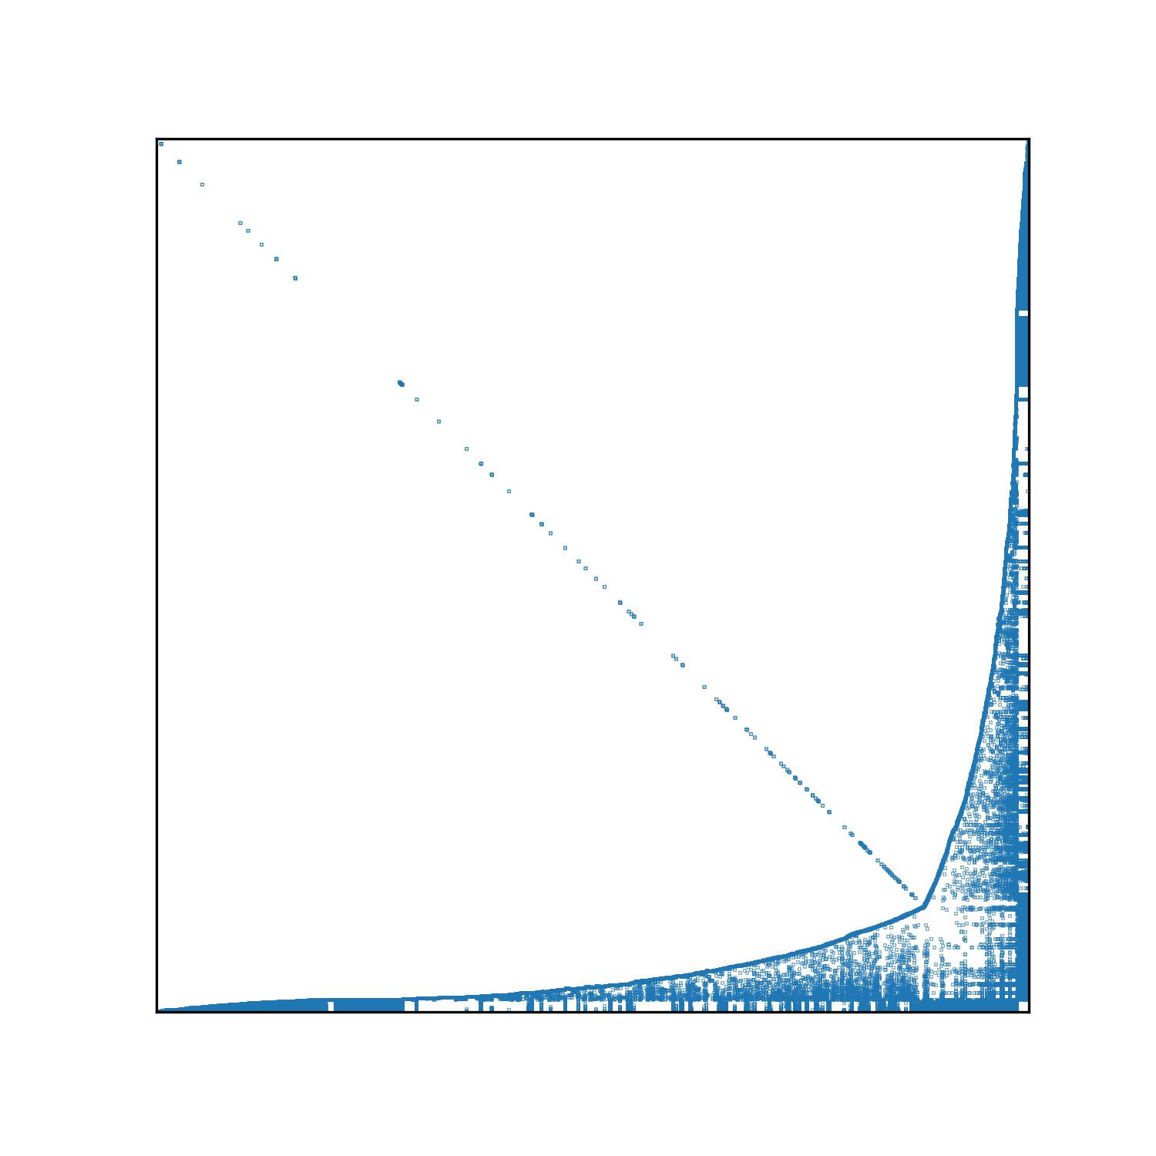
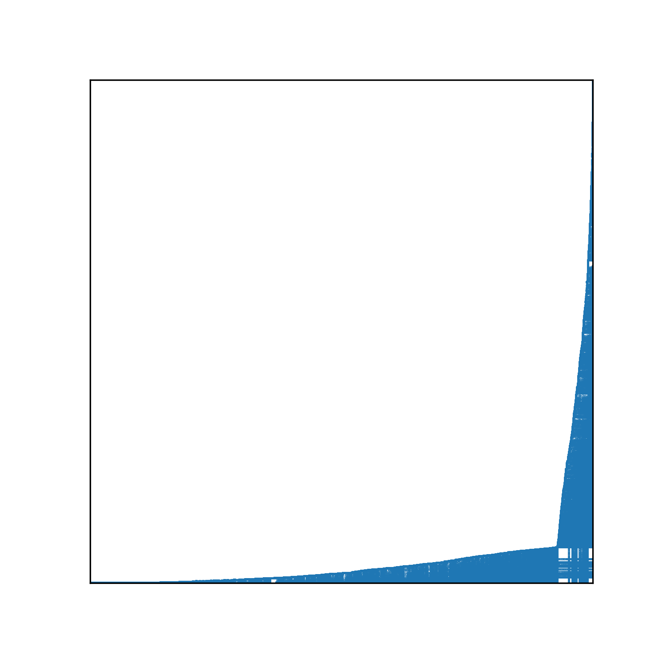
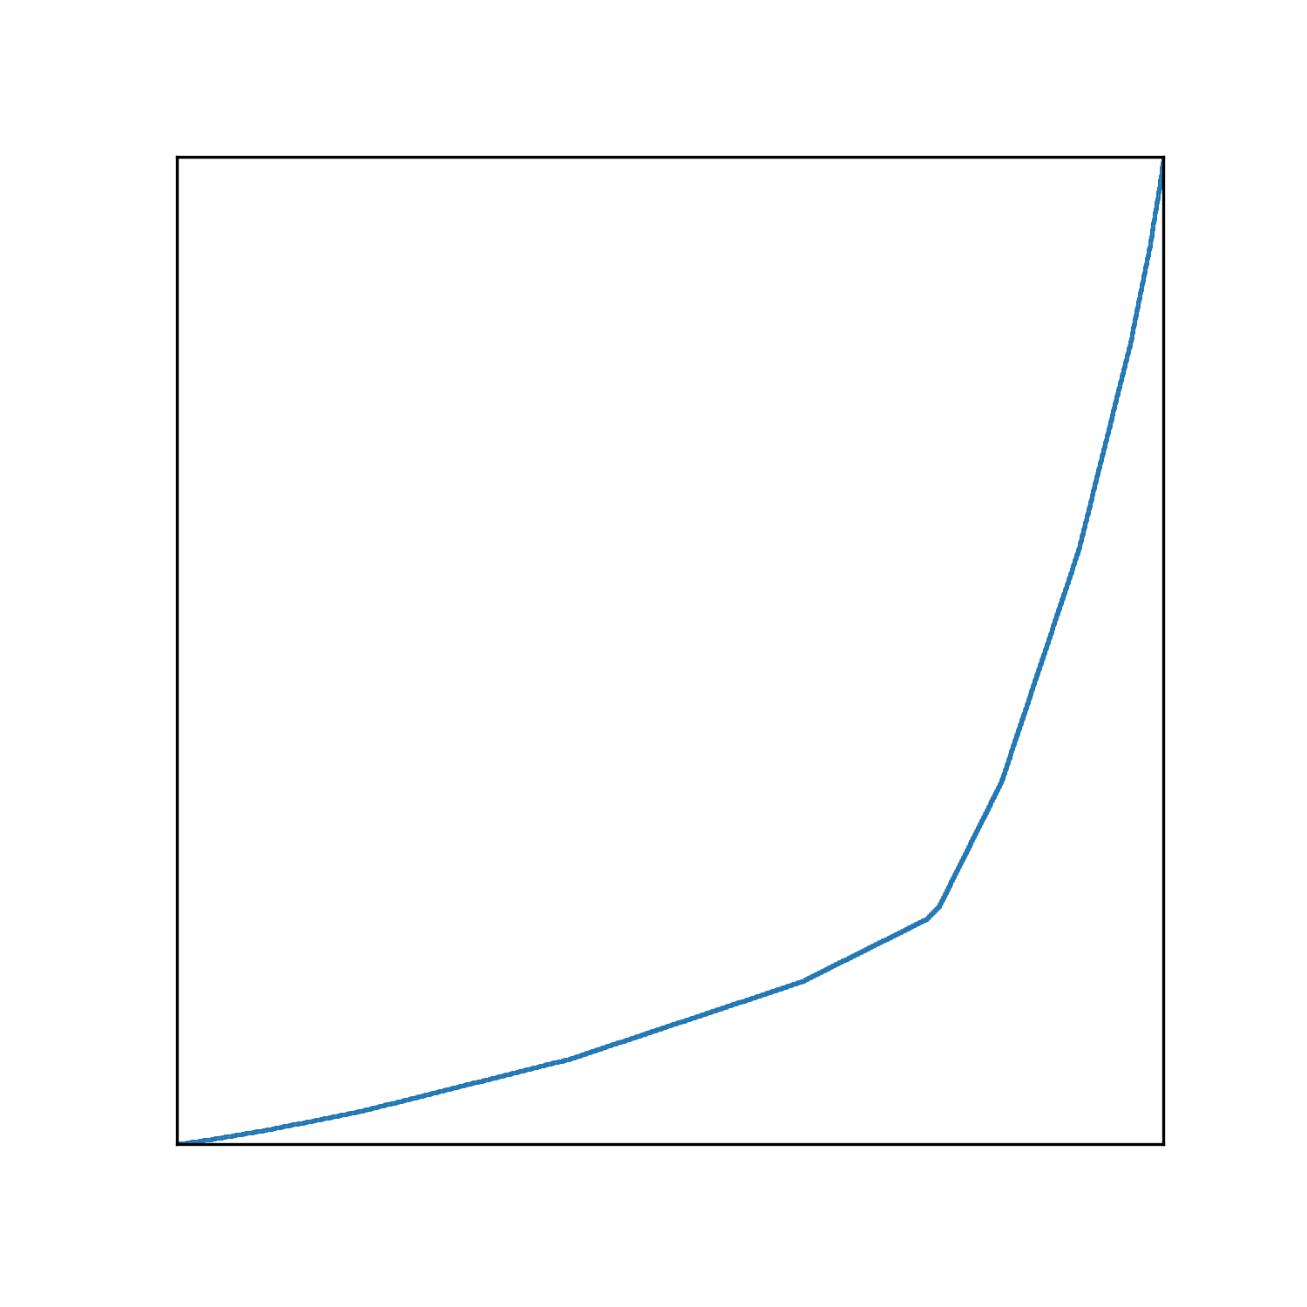
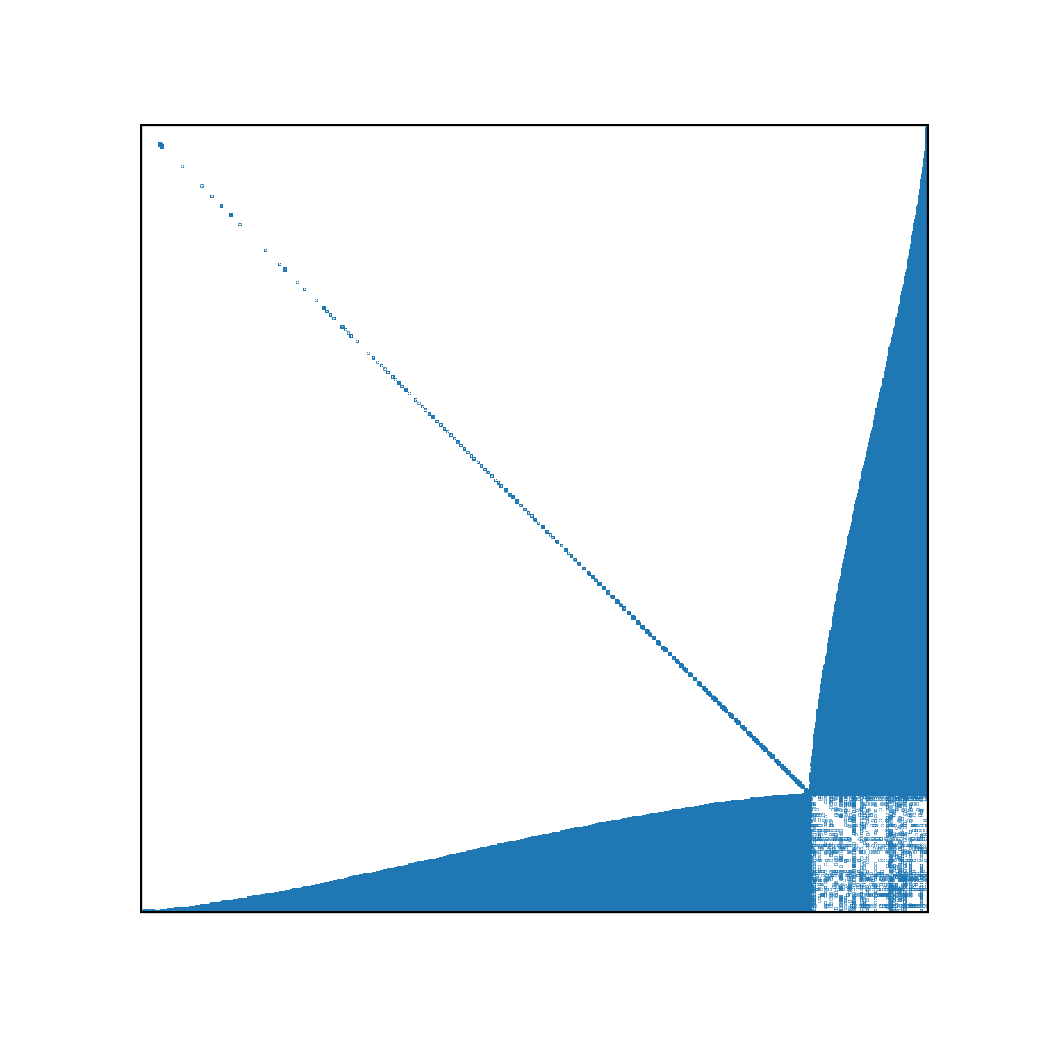
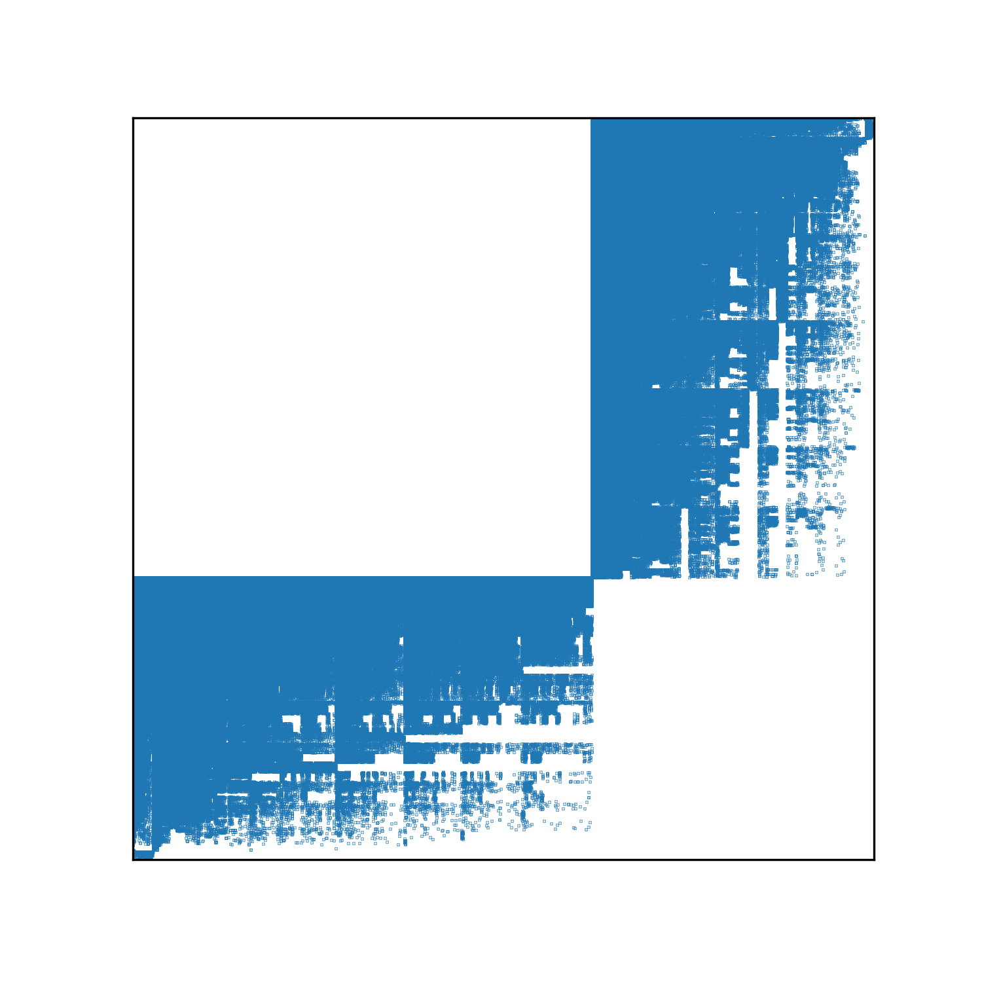
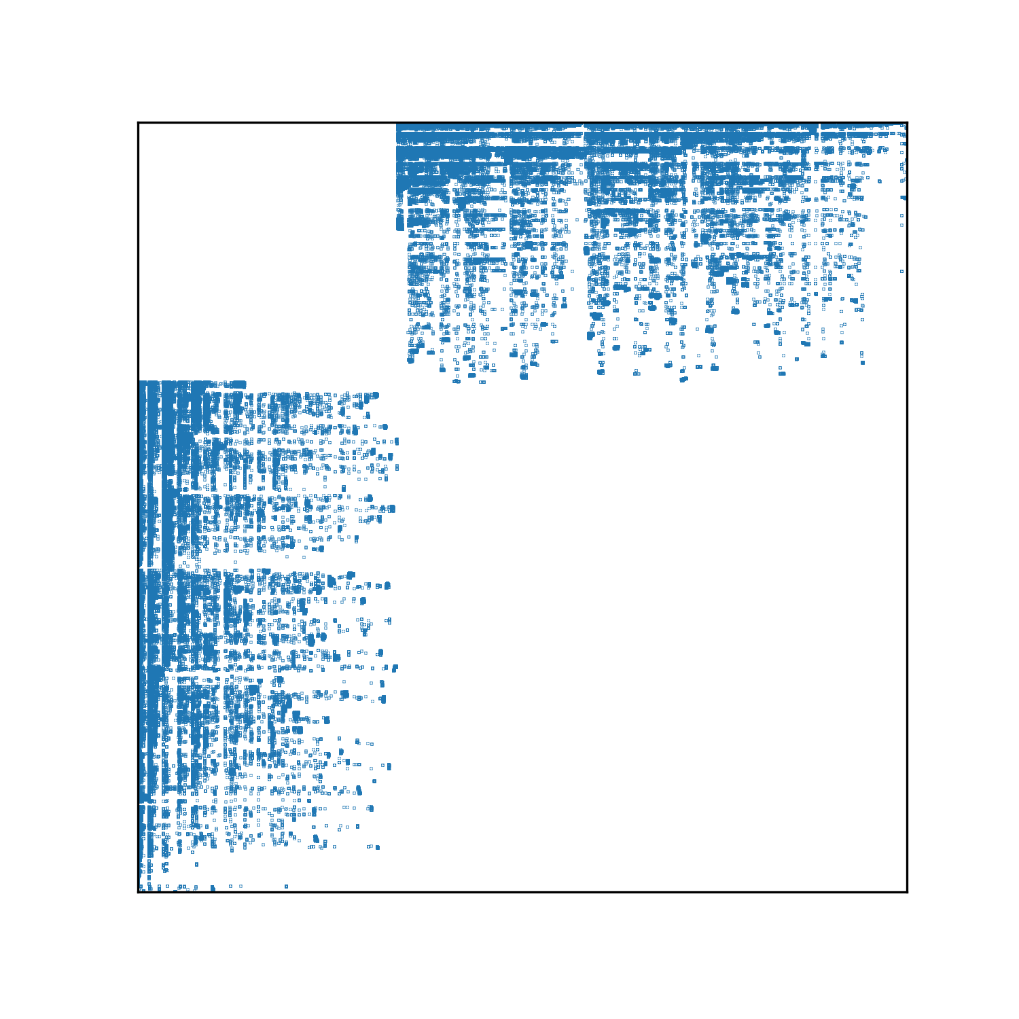
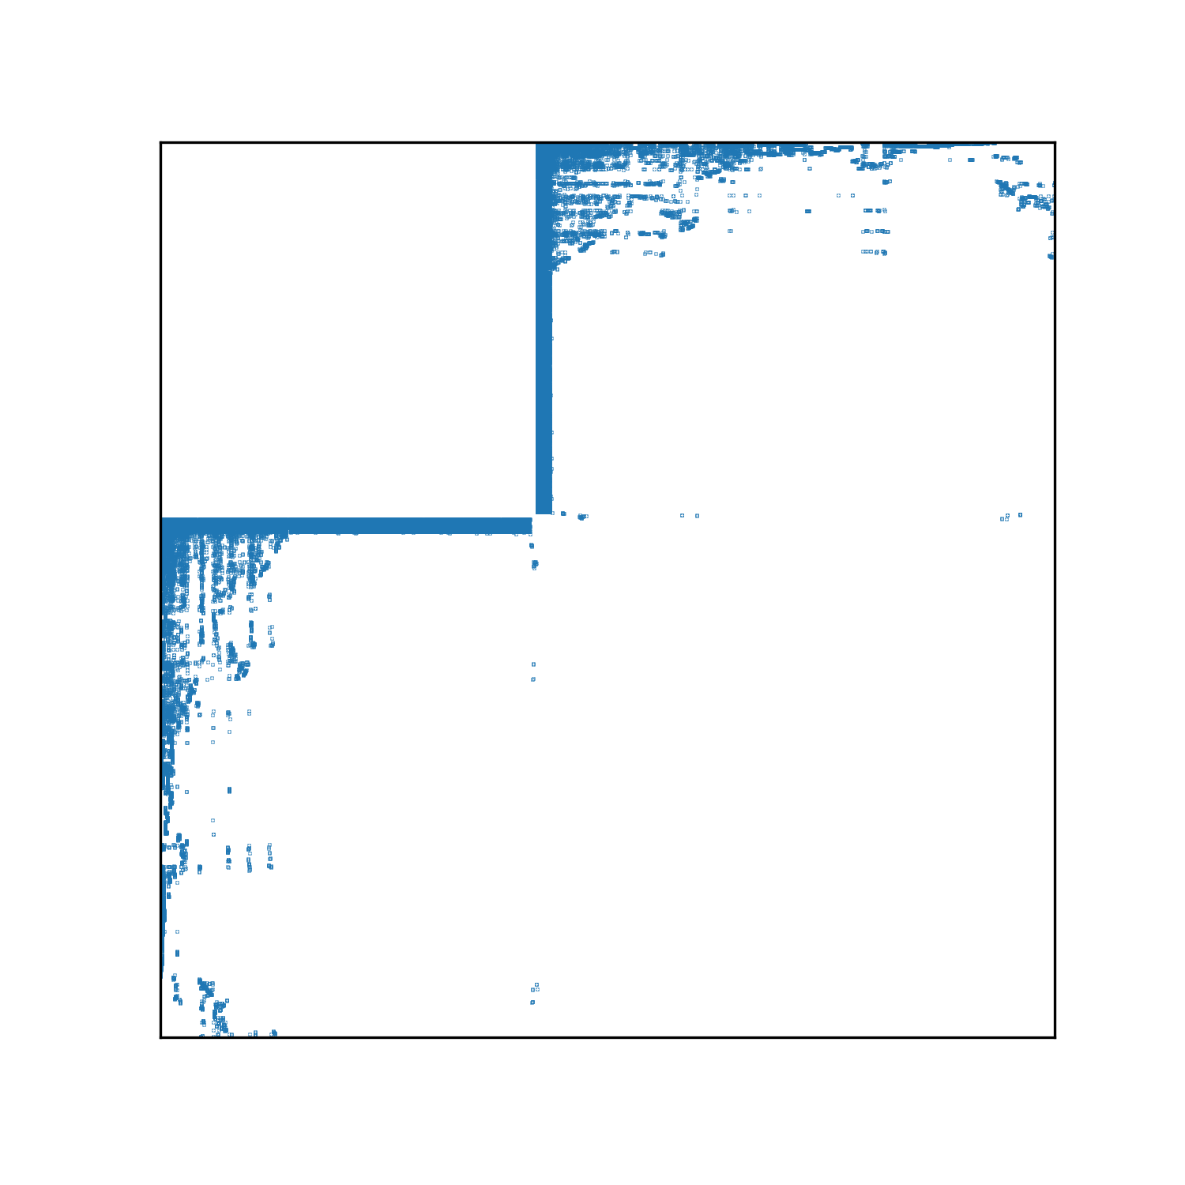
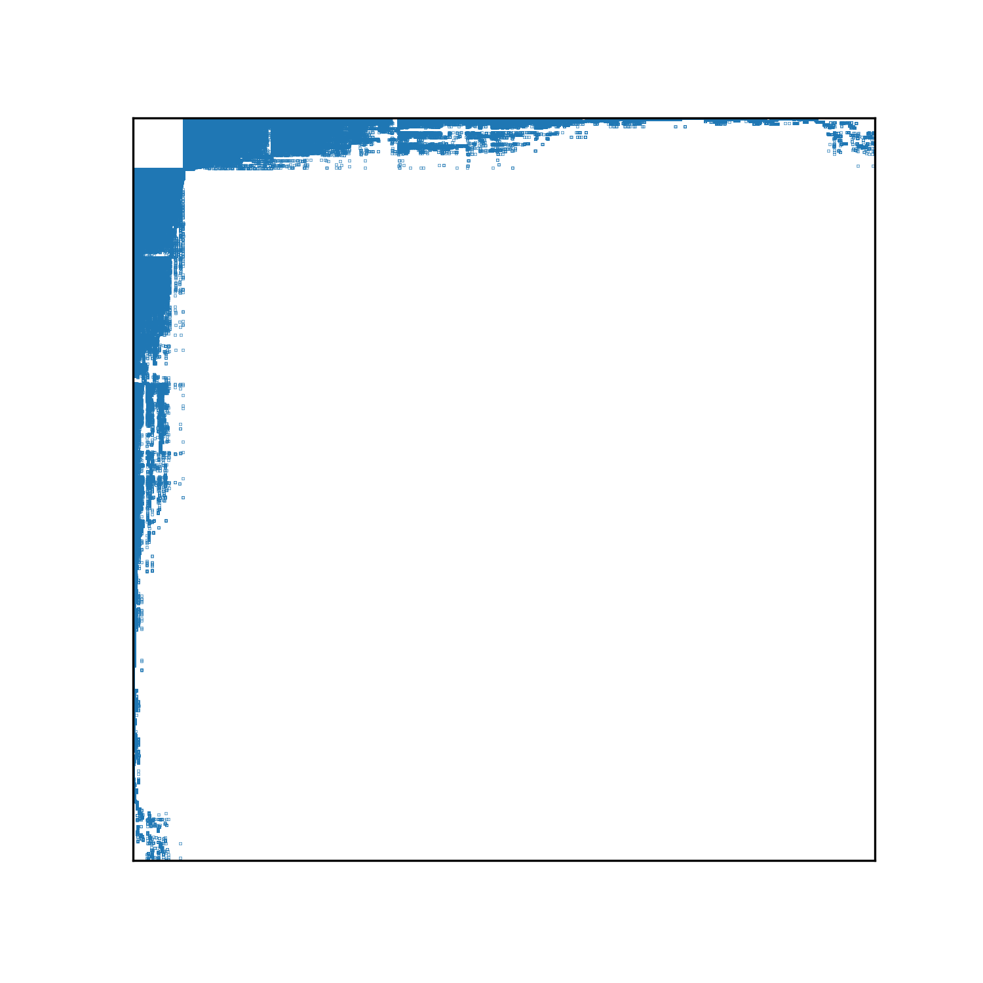
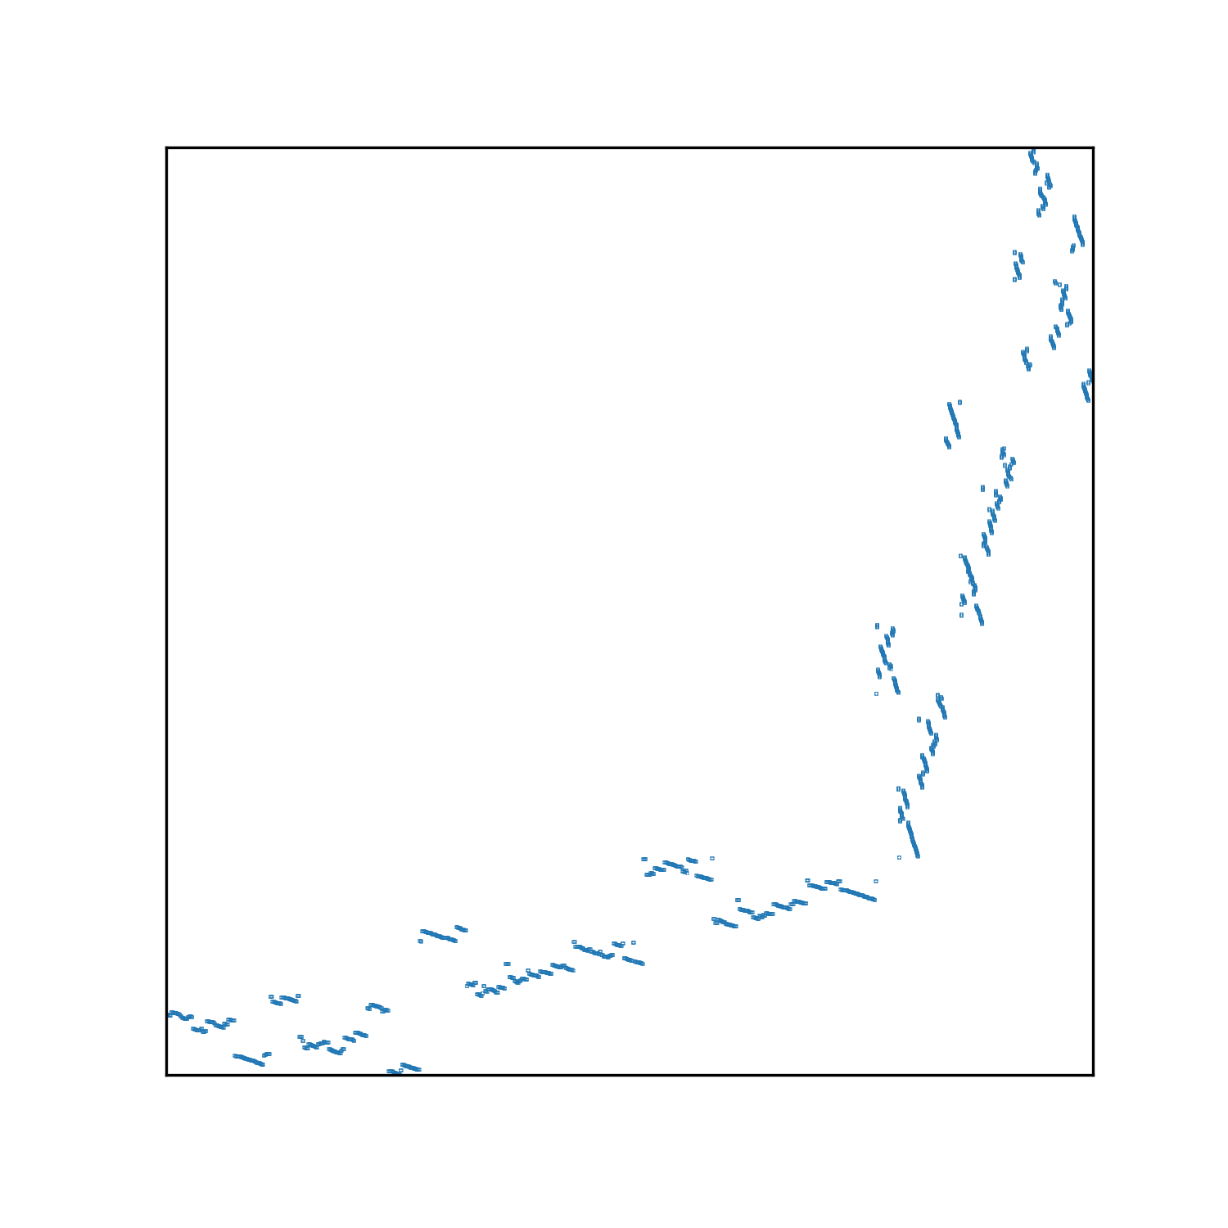
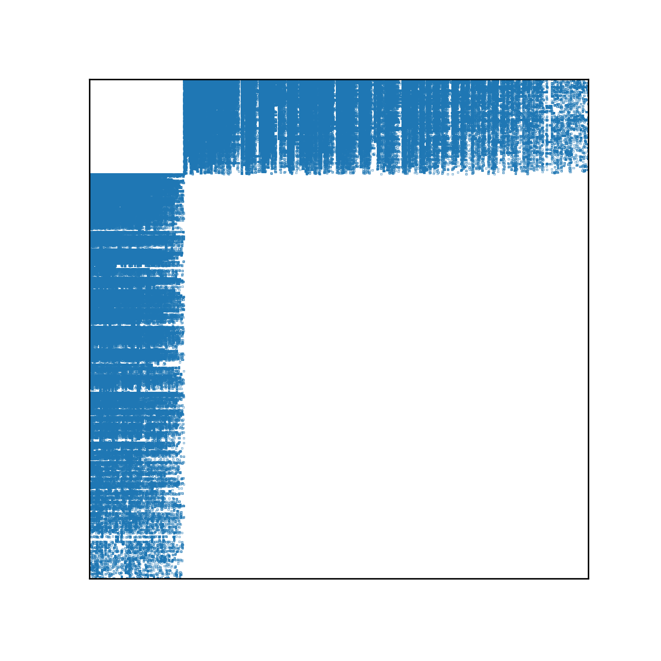
Experiments (3)
ML-1M
Marvel
FilmTrust
Movies
NIPS
IMDB
ML-1M
Marvel
FilmTrust
Movies
NIPS
IMDB
BFS
FastPI
SO
Bi-SO
SlashBurn
IBSO
Adjacency matrices of various methods.
Good methods gathers zero entries and make blank areas.
Separation between odd-depth and even-depth in BFS
Shattered fragments in SlashBurn and FastPI
Separation between two partitions in bipartite methods
Bi-SO and IBSO look similar

Slide 17
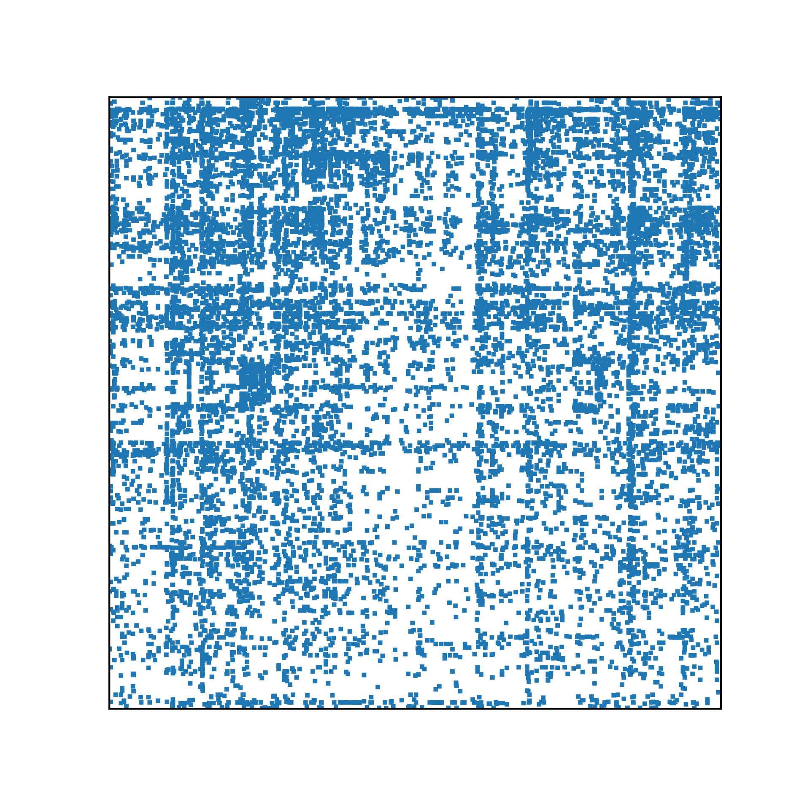

Experiments (4)
Submatrix of adjacency matrices on MovieLens-1M dataset.
IBSO shows the clear mosaic pattern distinct from Bi-SO
Because of the bucket min-hash function
Leads to lesser nonzero blocks
Bi-SO
IBSO

Slide 18
Conclusion
We propose IBSO, a compression friendly vertices reordering algorithm for bipartite graphs.
IBSO performs great in terms of the number of nonzero blocks in adjacency matrix in six real-world graphs.
The processing time of IBSO is scalable in large-scale graphs both in theoretical and practical.

